Slide 1
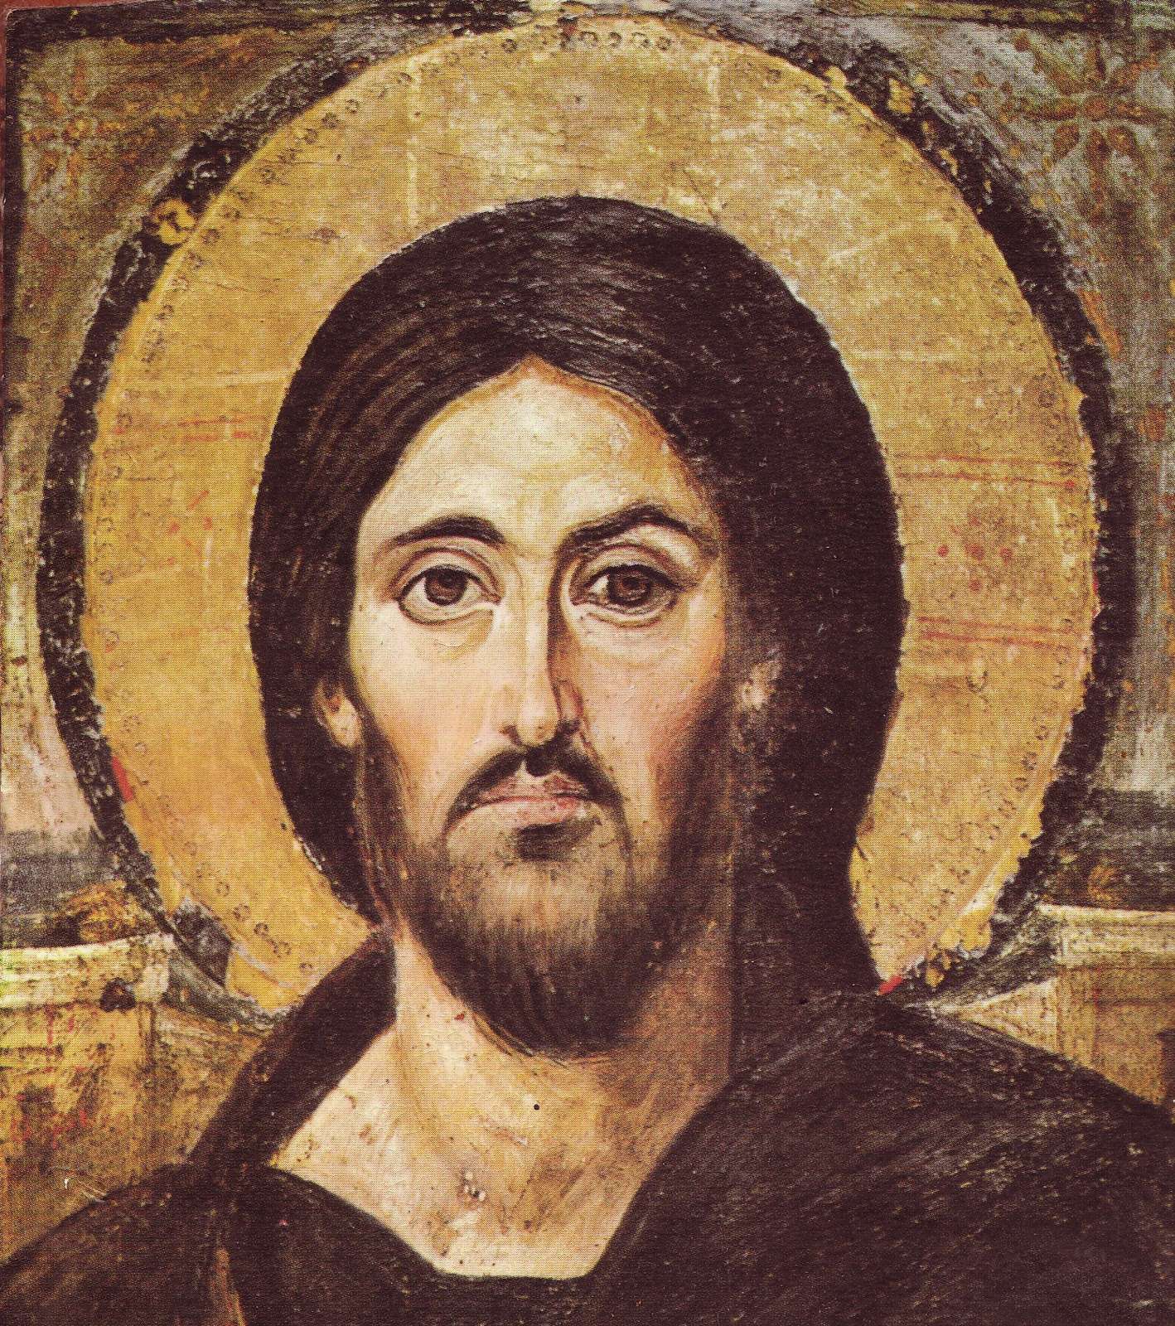
COINS FROM THE TIME OF JESUS
Christ Pantokrater, St Catherine’s Monastery, Sinai

Slide 2
Making ancient coins

Slide 3
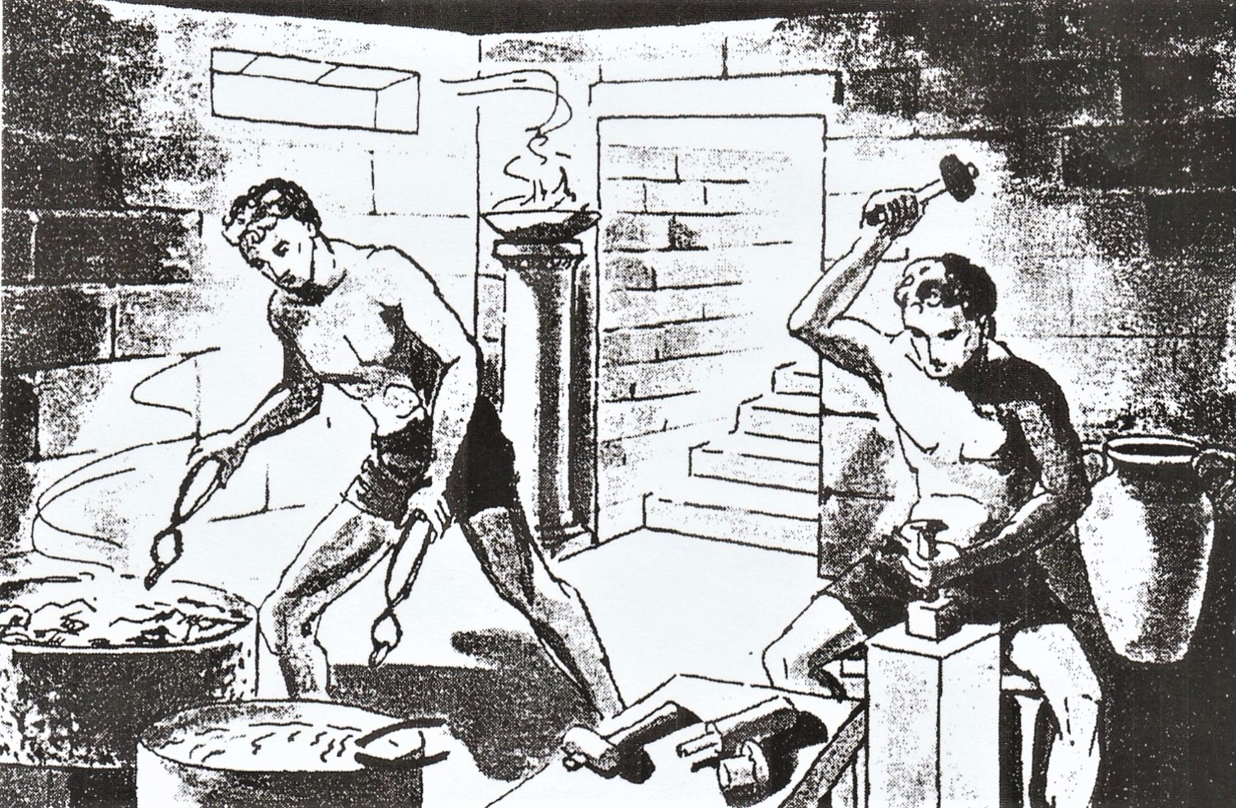
In ancient mints the coins were hand-struck while the heated metal was cooling.

Slide 4
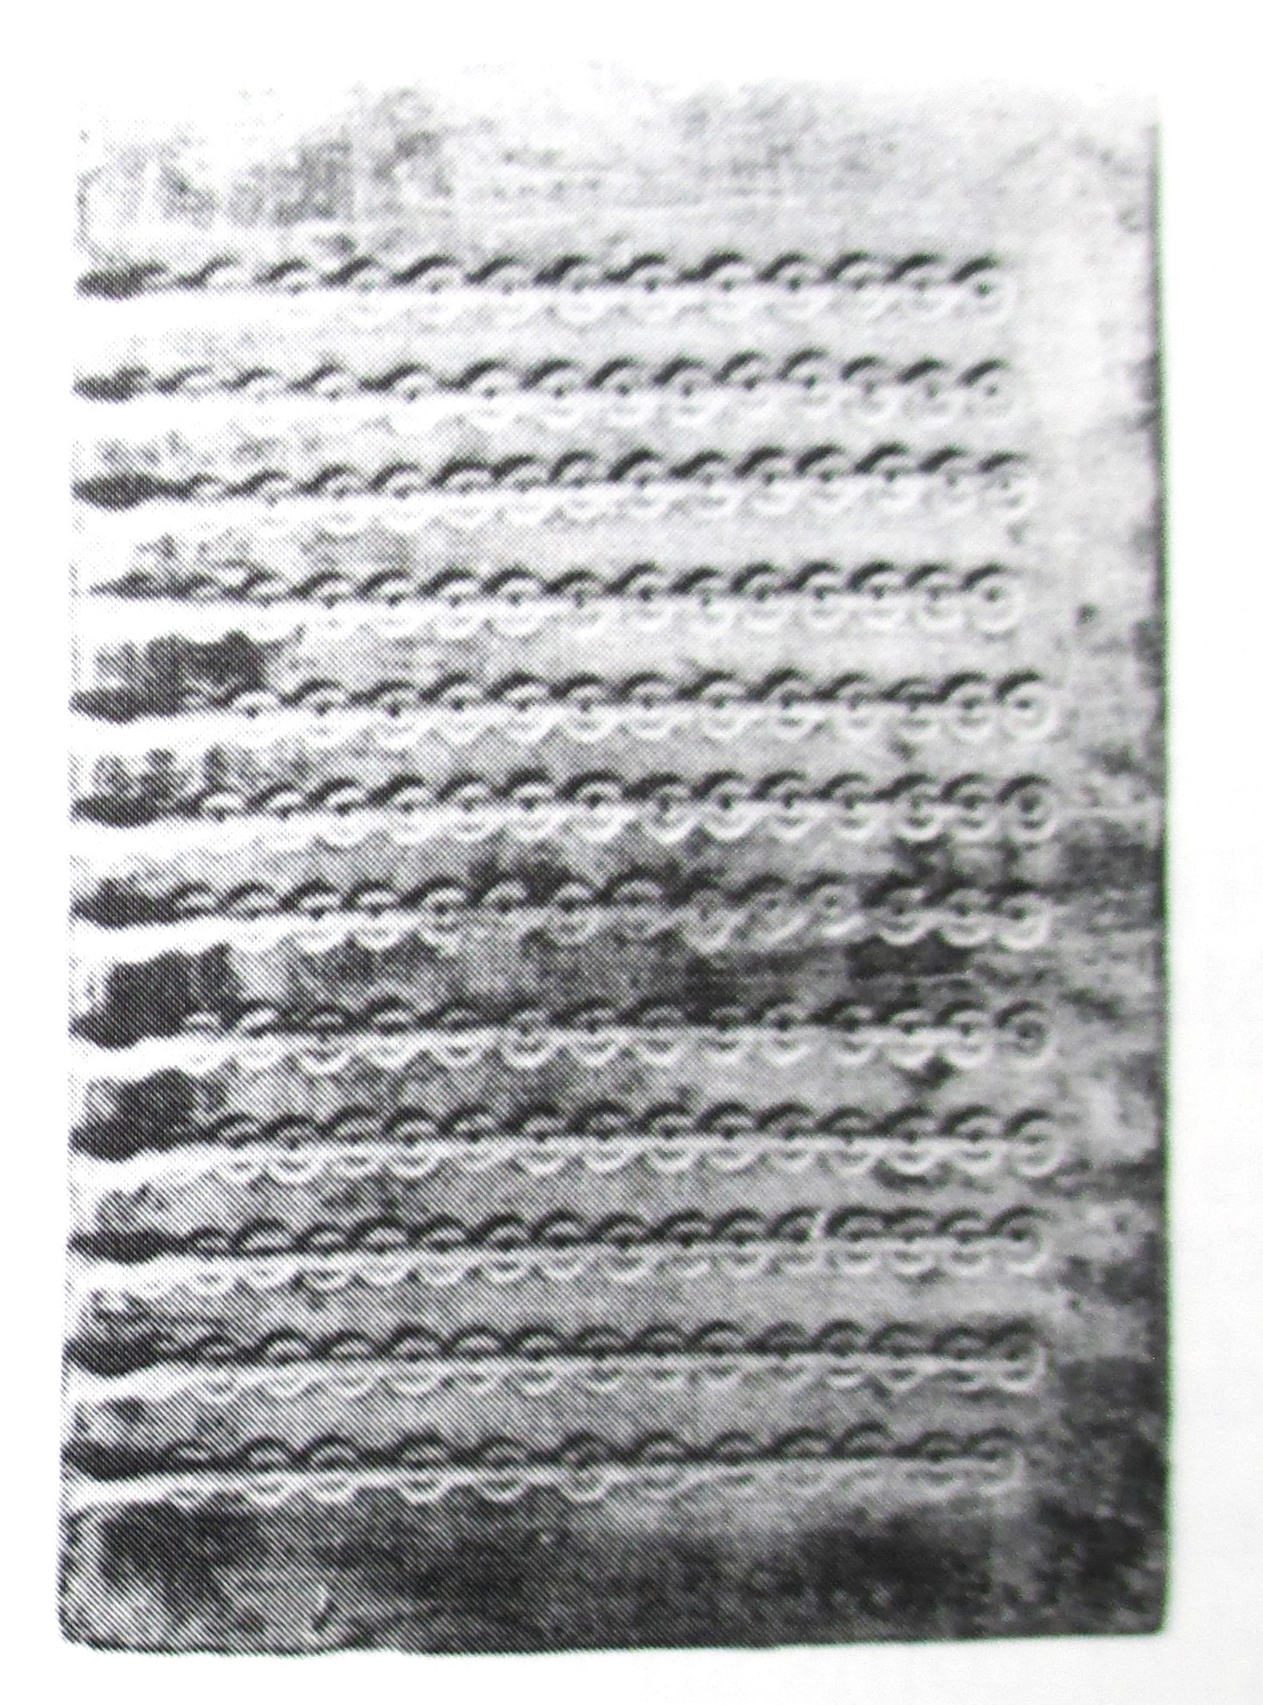
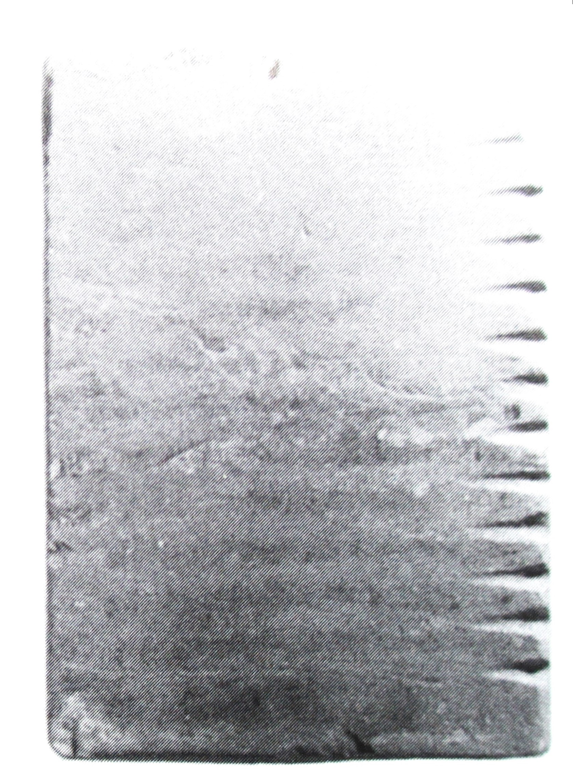
These chalkstone molds were discovered in Israel.
To make a strip of blanks, close the molds like a book and pour molten metal in the holes. Then open the molds and pull each hot strip over an anvil die and strike it with a hammer die to make a strip of coins.

Slide 5
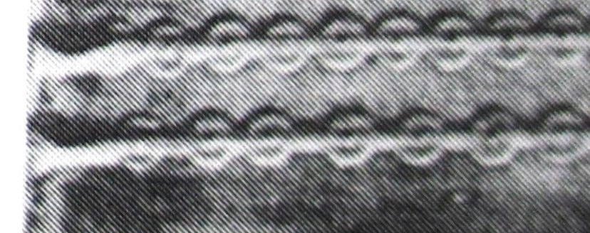
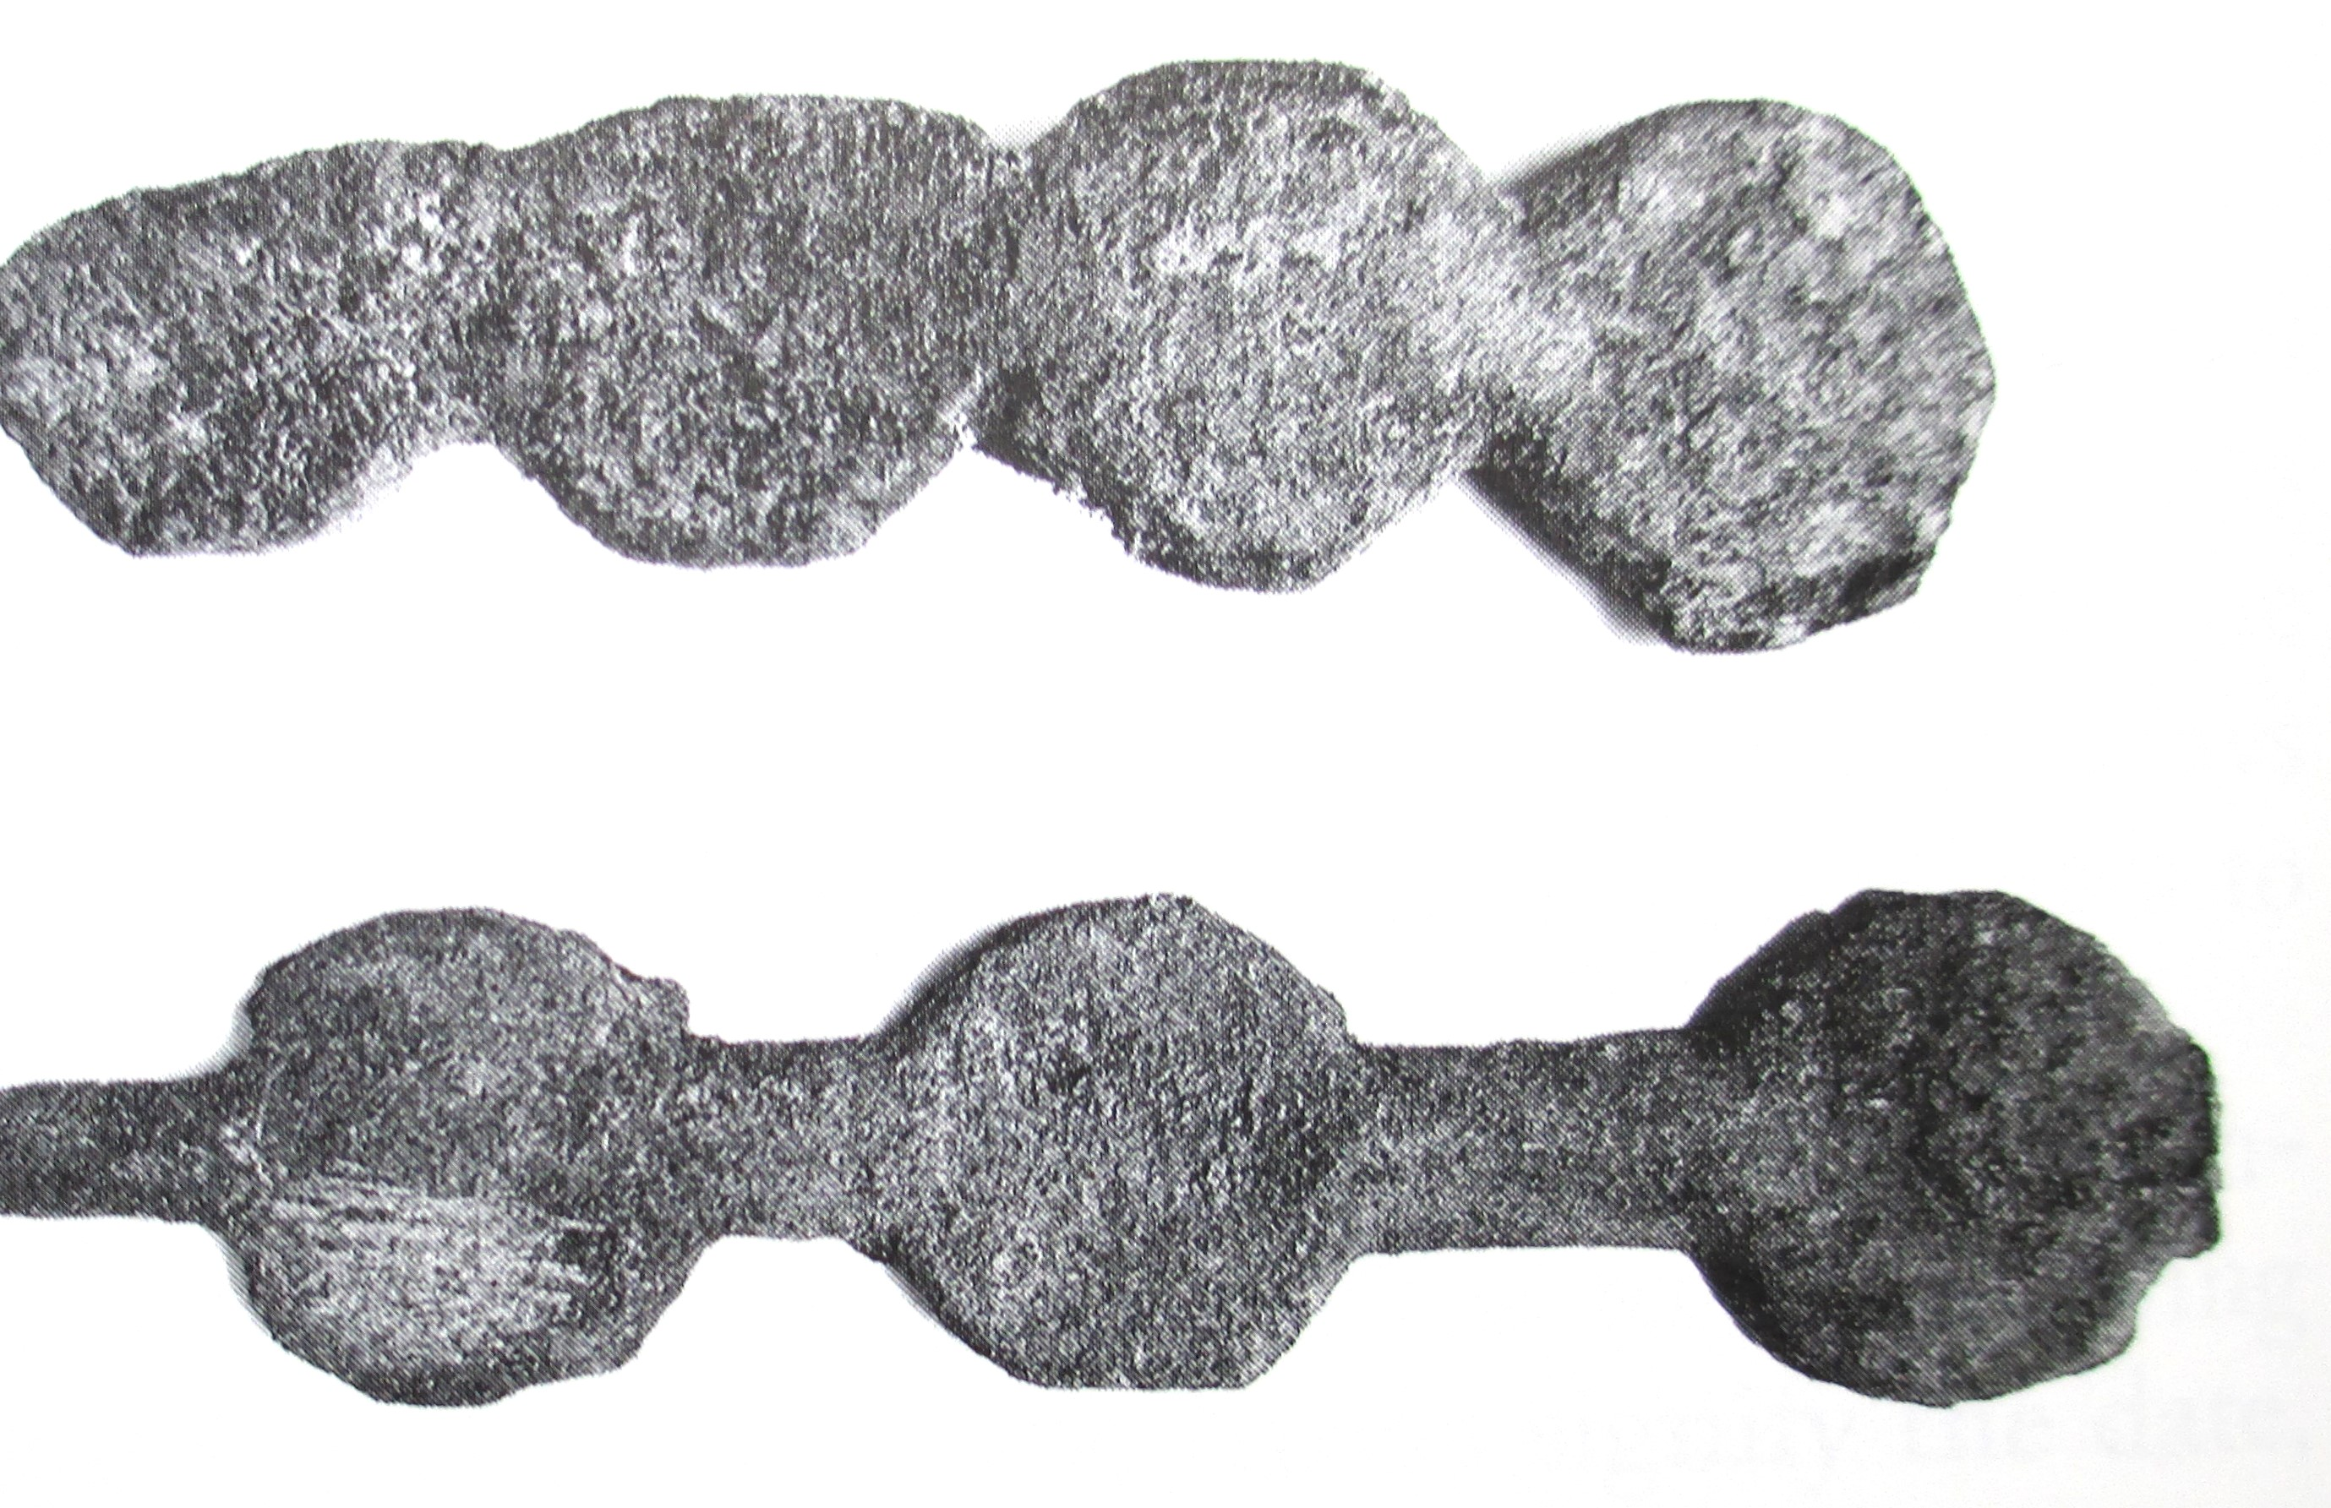
Bottom 2 rows in the mold
2 strips of blanks

Slide 6
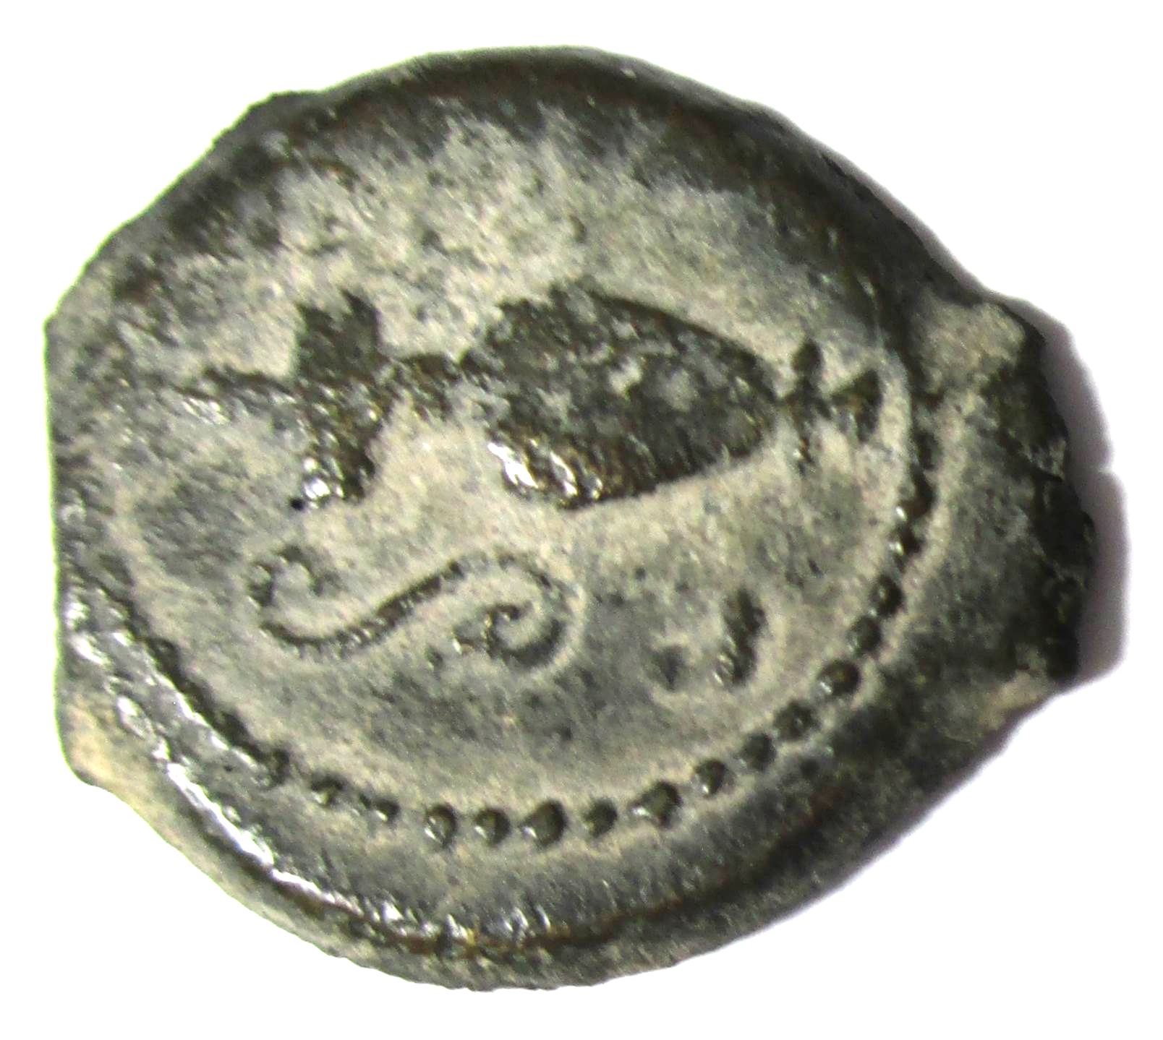
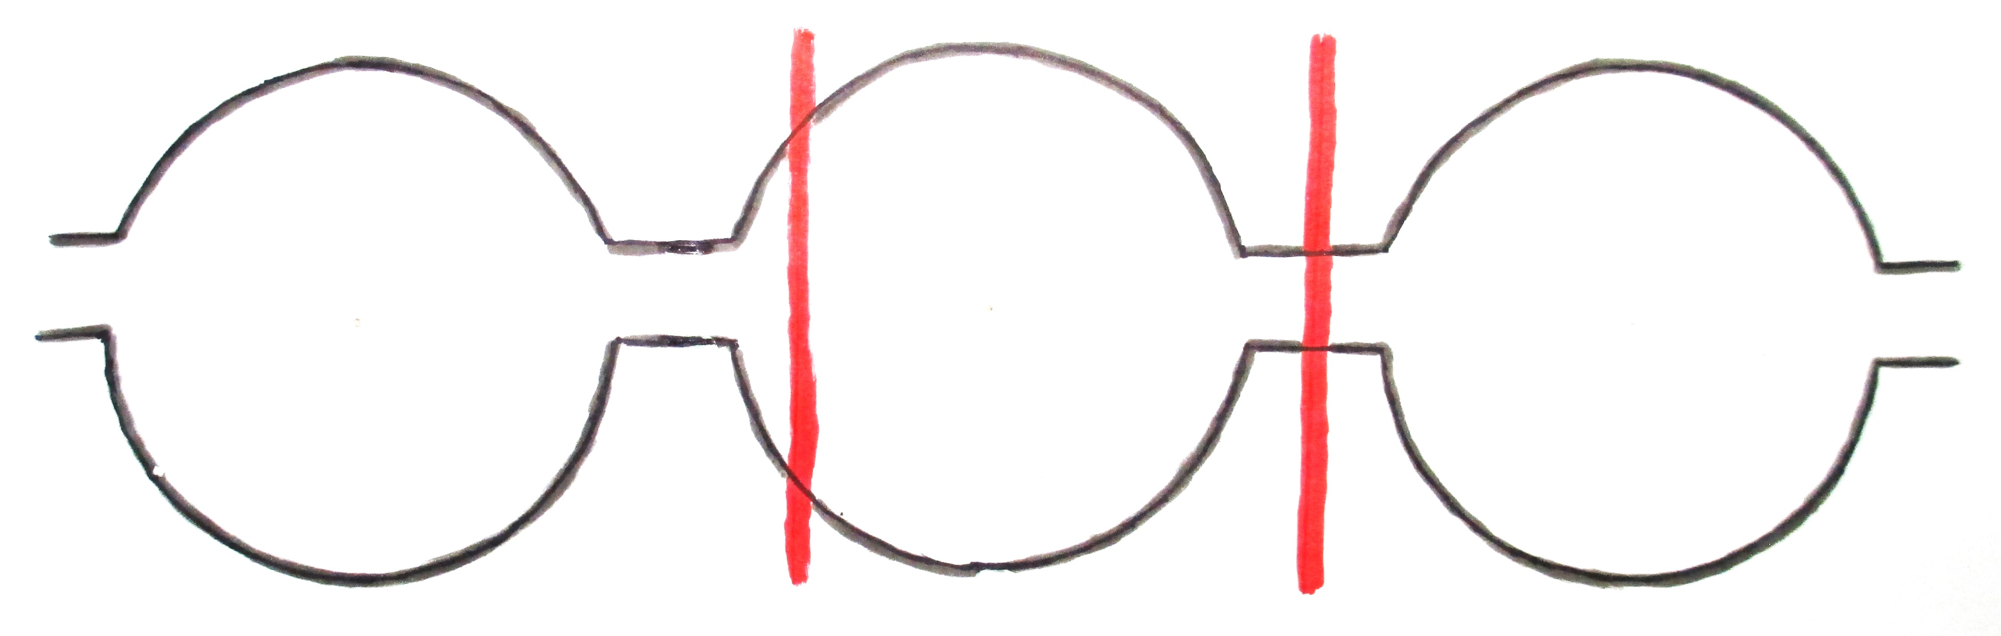
The strip of coins was chopped with an axe.

Slide 7
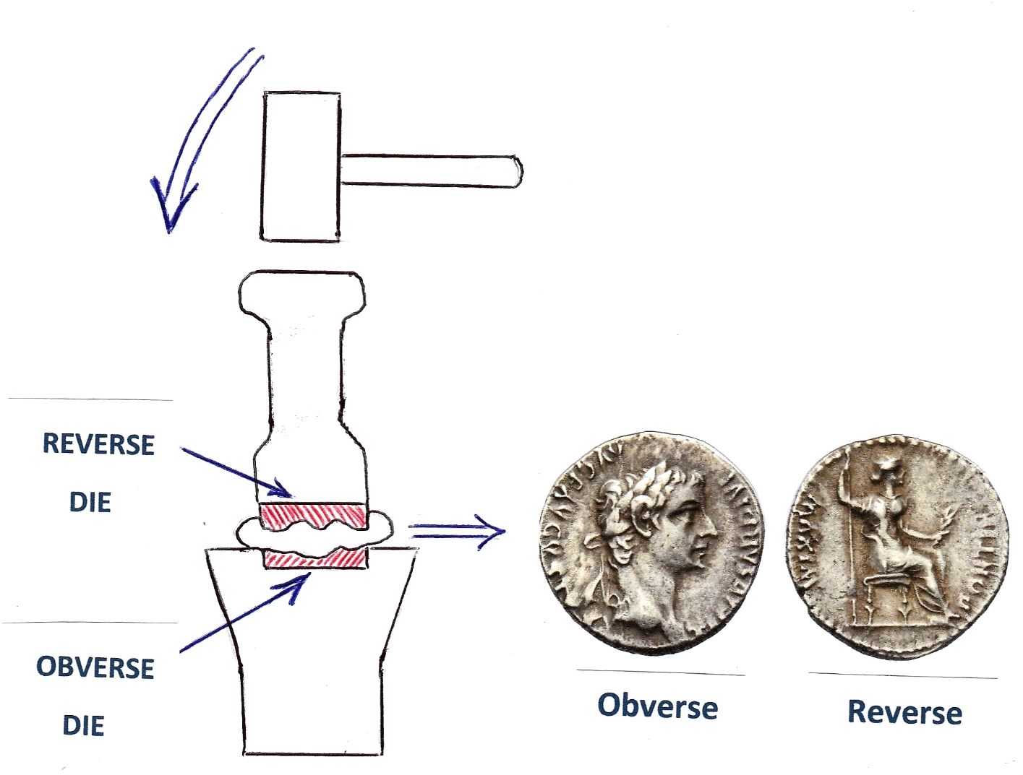
Striking an Ancient Coin
Denarius of Tiberius

Slide 8
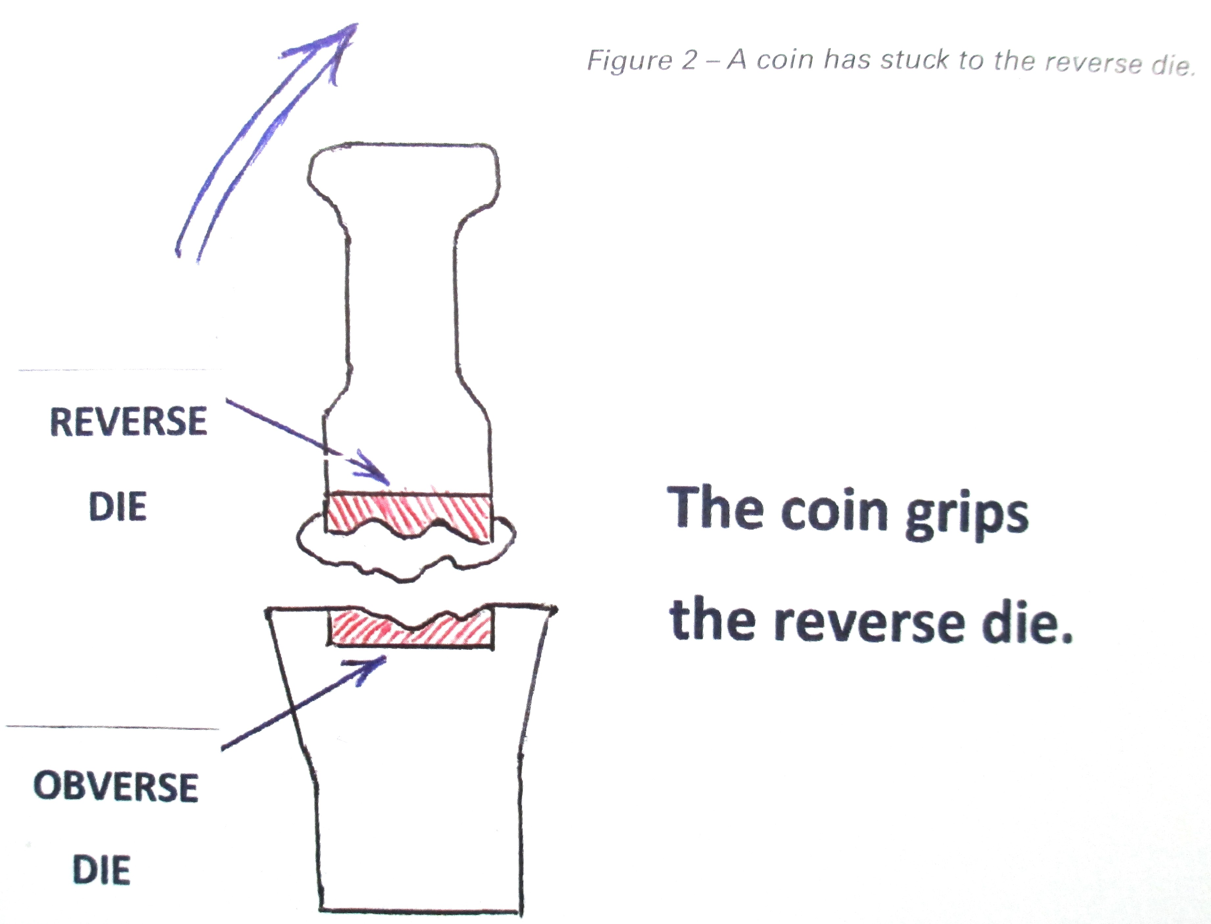

Slide 9
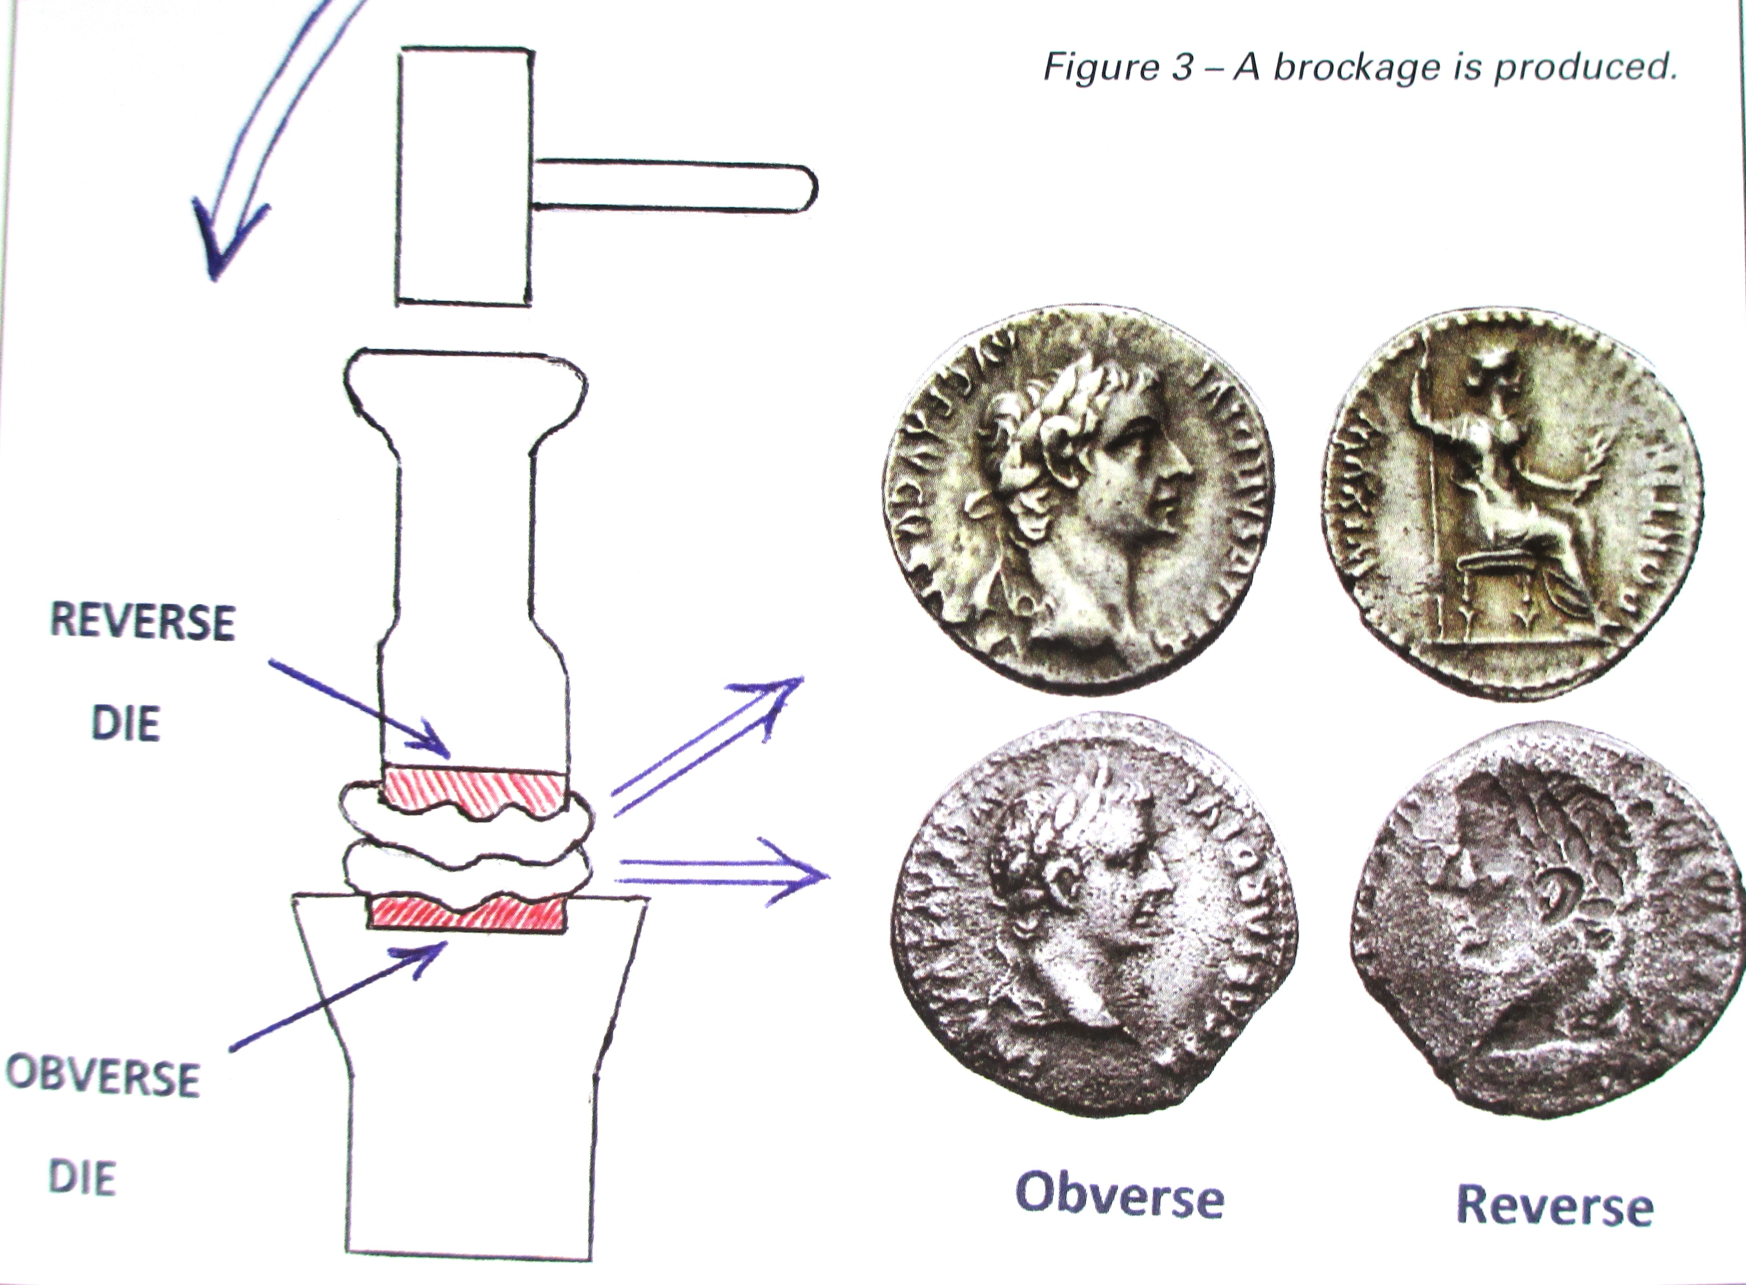

Slide 10
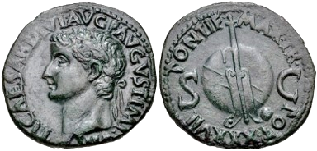
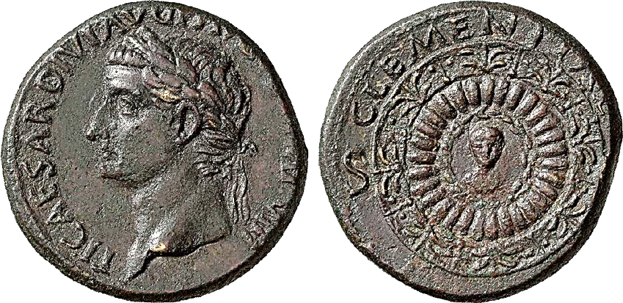
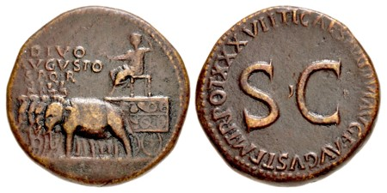
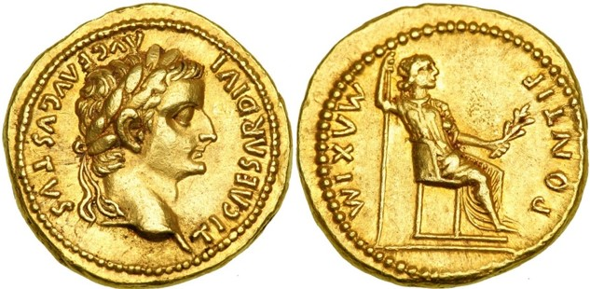
Roman Coin Denominations
AS DUPONDIUS = 2 asses
AUREUS = 25 denarii
DENARIUS = 16 asses
SESTERTIUS = 4 asses

Slide 11
The Herodian dynasty

Slide 12
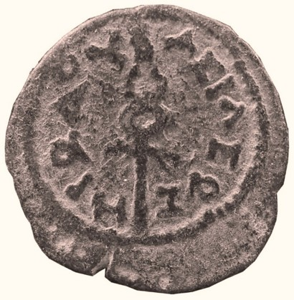
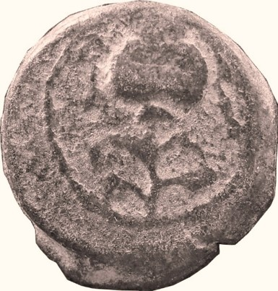
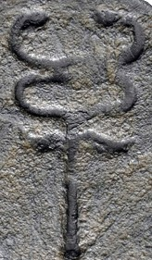
COIN 1 King Herod the Great
CCCRH #1587
caduceus
Herod was king of the Jews when Jesus was born.
OBVERSE: a caduceus with ‘King Herod’ in Greek.
A caduceus was the magic wand of the god Mercury, and here it is probably meant to be a symbol of peace.
REVERSE: a poppy pod on a branch.

Slide 13
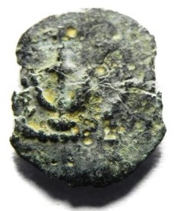
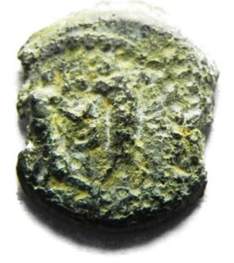
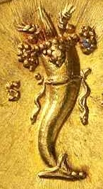
COIN 2 Herod the Great
CCCRH #2765
cornucopia
OBVERSE: anchor with ‘King Herod’ in Greek.
Jewish law forbade human images.
REVERSE: a caduceus between two cornucopias.

Slide 14
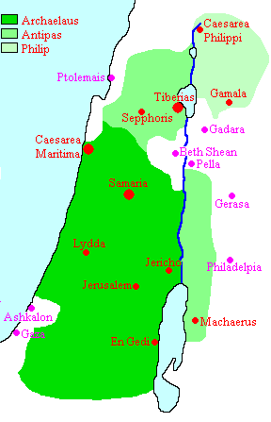
The Kingdom of Herod
When Herod died in 4 BCE his territory was divided between 3 surviving sons.
Archelaus: ethnarch of Judaea & Samaria (centre)
Antipas: tetrarch of Galilee and Perea (north & east)
Philip: tetrarch of the territory to the north-east of the Sea of Galilee

Slide 15
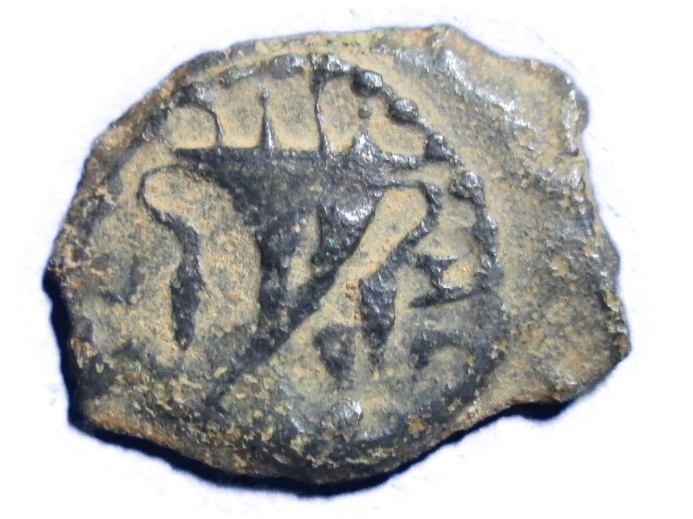
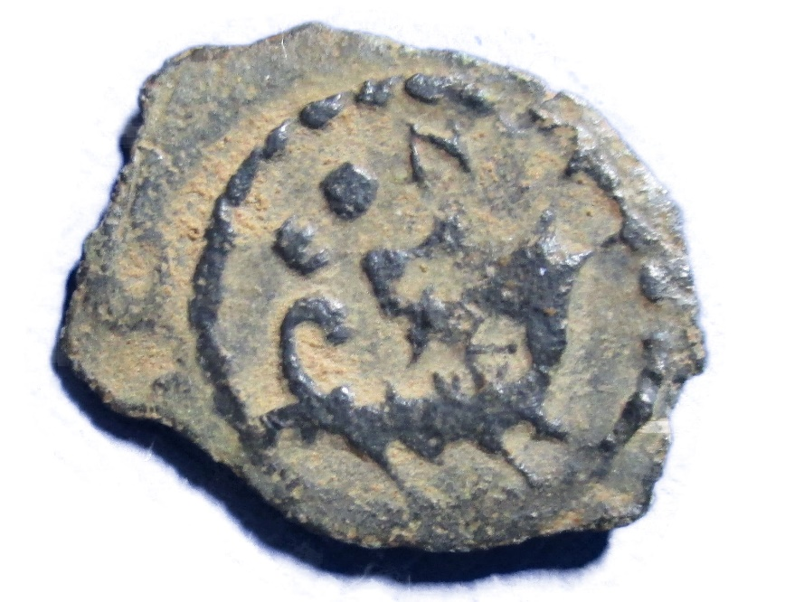
COIN 3 Herod Archelaus
CCCRH #495
Archelaus ruled Judaea from 4 BCE to 6 CE. He was so cruel that the Jews asked the Roman emperor, Augustus, to get rid of him. He is mentioned in Matthew 2:22.
OBVERSE: double cornucopias with the Greek word ‘Herod’.
REVERSE: ΕΘΝΑΡΧ (ethnarch) above a war galley.

Slide 16
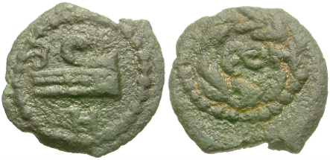
COIN 4 Herod Archelaus
CCCRH #2682
OBVERSE: ram on ship’s prow with Greek letters for ‘Herod’.
REVERSE: Greek letters ΕΘΝ for ‘ethnarch’ within a wreath.

Slide 17
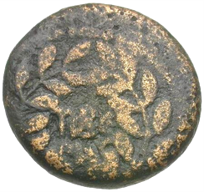
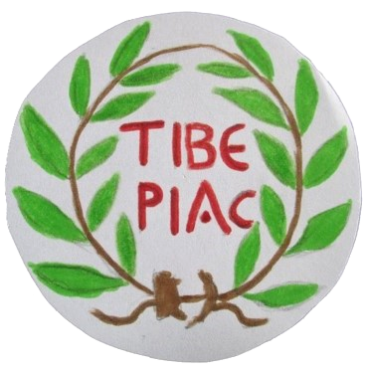
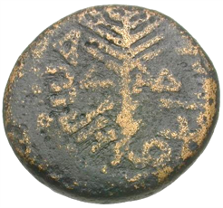
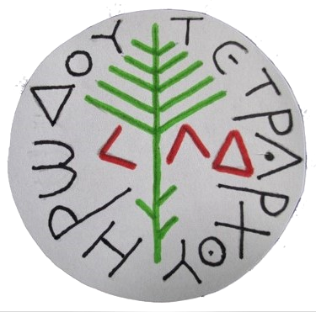
COIN 5 Herod Antipas
Half denomination
CCCRH #2670
OBVERSE: ‘Tiberias’ in Greek in a wreath.
REVERSE: a palm branch with ‘of Herod Tetrarch’ and the date ‘year 34’ (= 30 CE) in Greek.

Slide 18
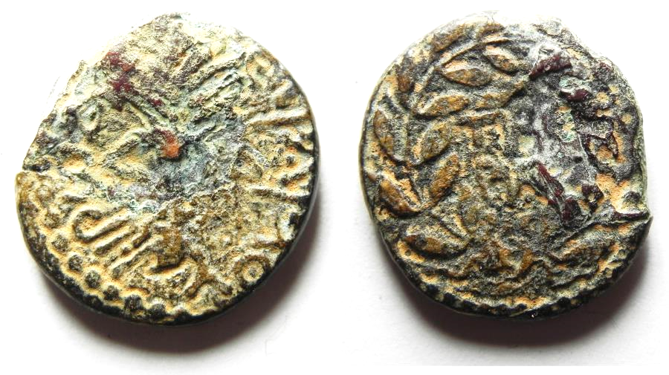
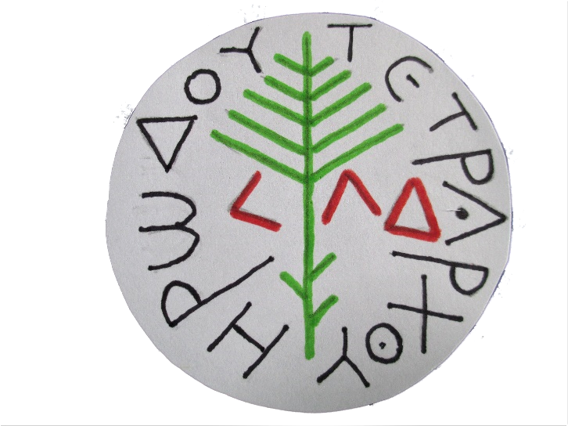
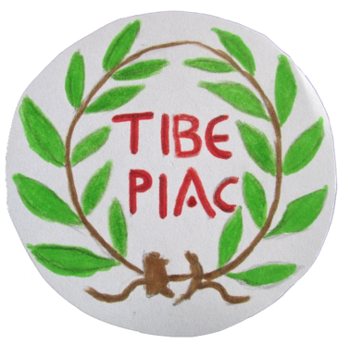
COIN 6 Herod Antipas
CCCRH #230
Full denomination
OBVERSE: The date is ‘year 34’ (= 30 CE) when Jesus was crucified.
REVERSE: Tiberias. It was the city founded by Antipas.

Slide 19
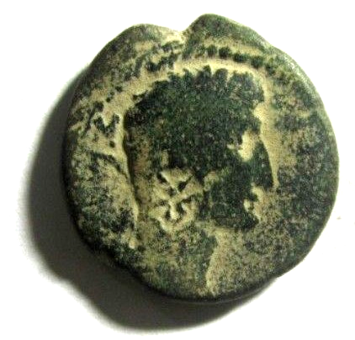
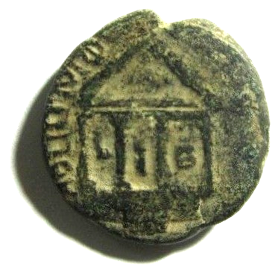
COIN 7 Philip the Tetrarch
CCCRH #1907
This coin was minted in Caesarea Philippi.
Jesus went to the surrounding villages. (Mark 8:27)
OBVERSE: head of Augustus with star countermark.
REVERSE: the Augusteum at Caesarea Philippi. Between the columns LIB means ‘year 12’ = 9 CE.

Slide 20
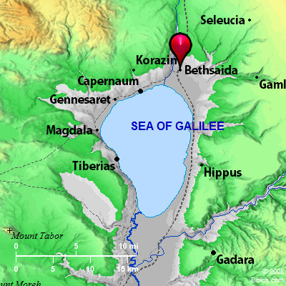
Peter, Andrew and Philip came from Bethsaida.

Slide 21
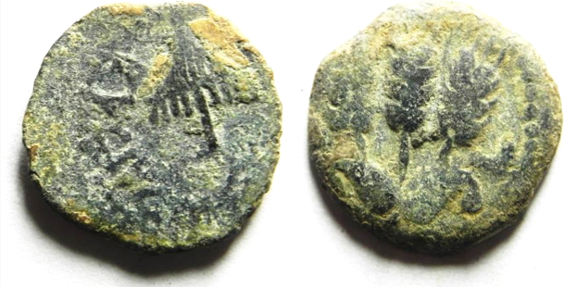
COIN 8 Agrippa I
CCCRH #2277
Grandson of Herod I: in 37 CE became king over the areas once ruled by Philip. The territories of Antipas were added in 40 and Judaea was added in 41 CE. He died in 44 CE.
OBVERSE: The fringed canopy (held over royal persons) refers to Agrippa. The inscription means ‘of King Agrippa.’
REVERSE: three ears of grain.

Slide 22
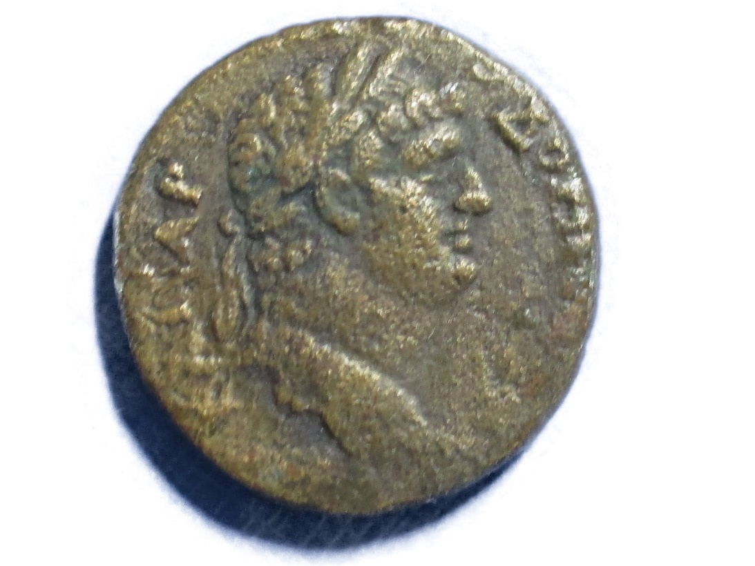
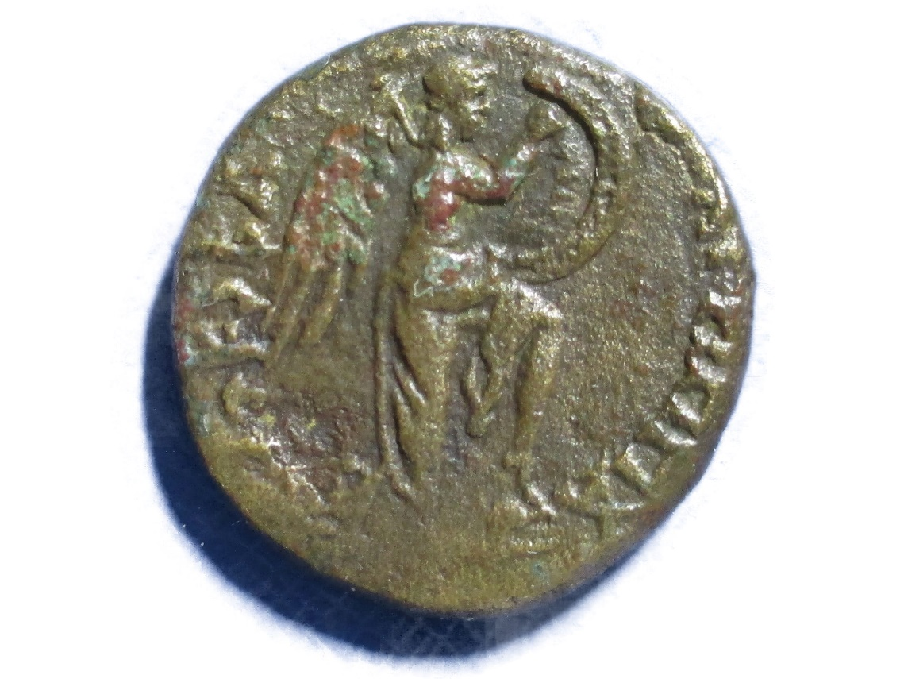
COIN 9 King Agrippa II
CCCRH #230
Agrippa II was the son of Agrippa I. His jurisdiction excluded Judaea which was under direct Roman rule. He sided with the Romans in the Jewish war (66-70 CE) and ruled until his death in mid-90s.
OBVERSE: Domitian, second son of the Roman emperor, Vespasian.
REVERSE: Victory writes on a shield. The date (74 CE) is on the left and ‘King Agrippa’ in Greek is on the right.

Slide 23
Roman rulers during the life of Jesus

Slide 24
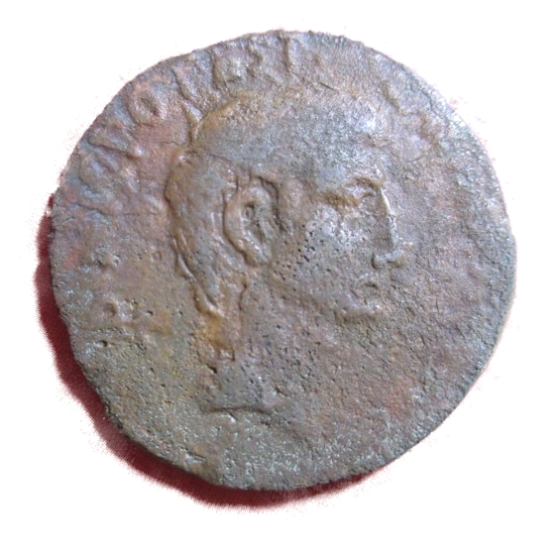
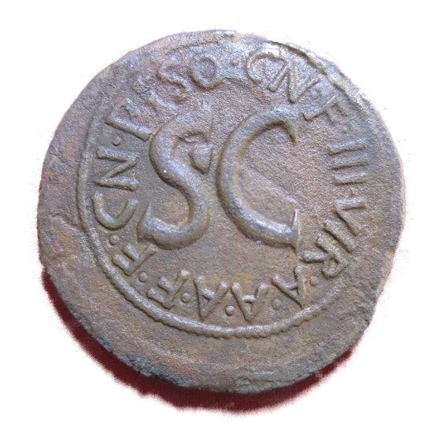
COIN 10 Augustus
CCCRH #287
Augustus was emperor from 28 BCE to 14 CE. This coin was minted at Rome in 15 BCE.
OBVERSE: head of Augustus
REVERSE: SC (Senatus Consulto) = ‘by decree of the Senate’.

Slide 25
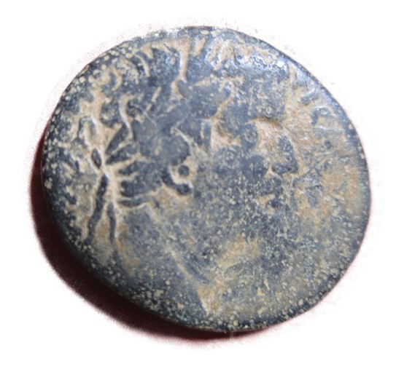
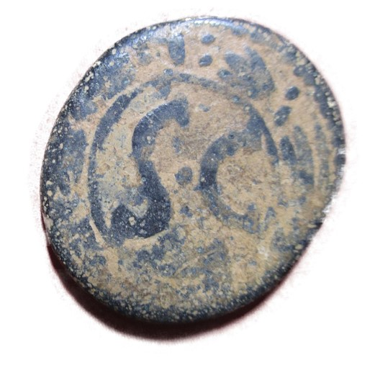
COIN 11 Tiberius
CCCRH #281
Tiberius was the emperor from 14 to 37 CE. This coin was minted at Antioch in 31 CE. Jesus’ followers were first called Christians in Antioch.
OBVERSE: Tiberius.
REVERSE: SC

Slide 26
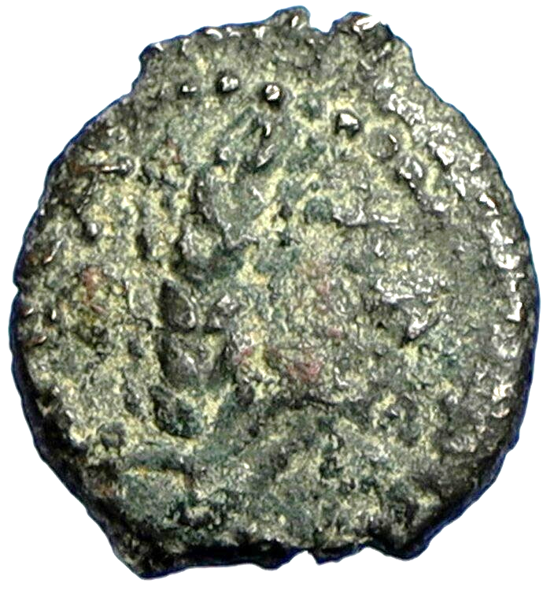
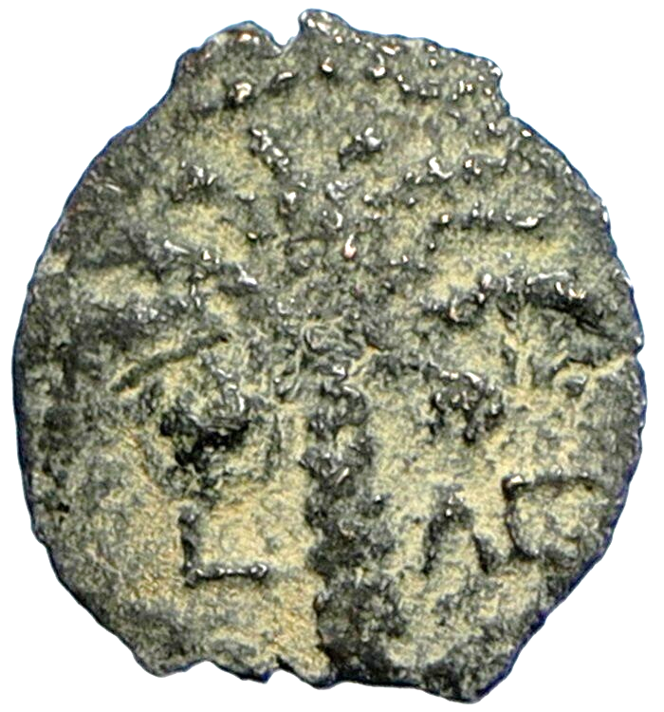
COIN 12 Coponius, Roman Governor of Judaea, 6-9 CE
CCCRH #3187
OBVERSE: ear of grain with KAICAPOS (of Caesar)
REVERSE: palm tree bearing 2 bunches of dates.
The date is 6 CE ‘year 36’ (after battle of Actium in 31 BCE)

Slide 27
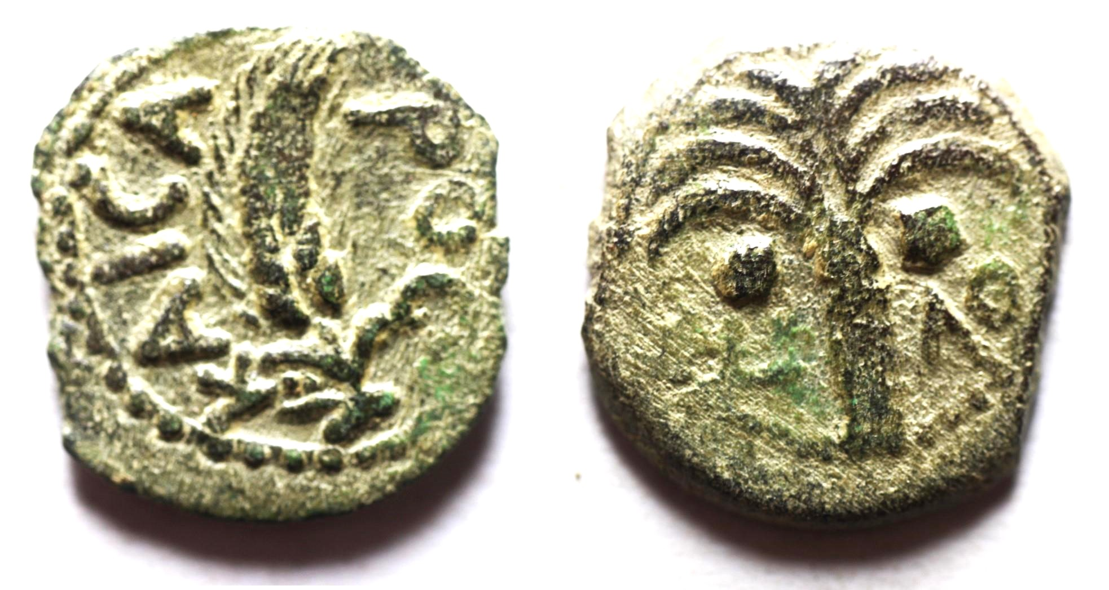
COIN 13 Marcus Ambibulus, Roman Governor of Judaea, 9-12 CE.
CCCRH #3191
OBVERSE: ear of grain with KAICAPOC.
REVERSE: date palm with date L ΛΘ (year 39 = 9 CE)
These coins indicate Judaea’s products: grain, dates, and wine.

Slide 28
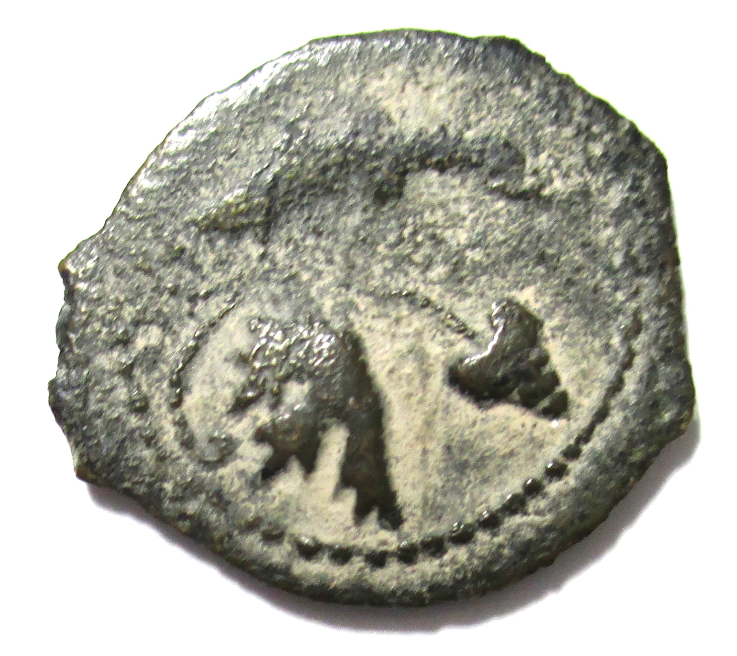
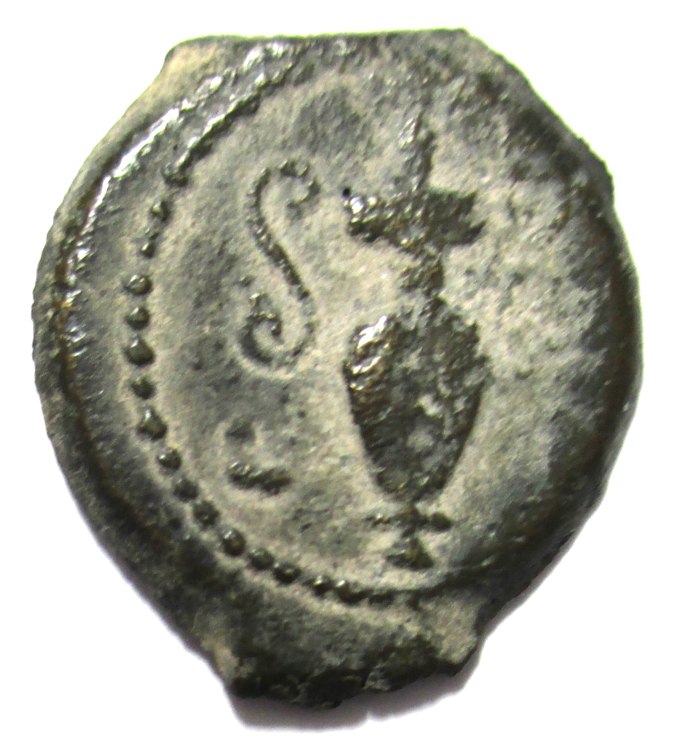
COIN 14 Valerius Gratus, Roman Governor of Judaea, 15-26 CE.
CCCRH #2184
OBVERSE: leaf and bunch of grapes. Workers in a vineyard were paid a denarius a day. (Matthew 20:2)
REVERSE: amphora with date L Δ (year 4 = 17 CE).
The shape of this coin reflects how coins were made in Judaea in the 1st century using molds for the hot metal.

Slide 29
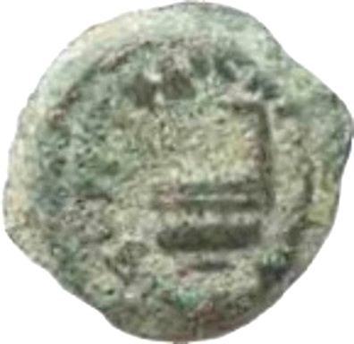
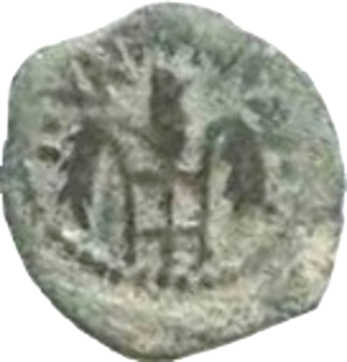
COIN 15 Pontius Pilate, 26–36 CE
CCCRH #2683
Roman procurator (governor) of Judaea, 26–36 CE.
OBVERSE: a ladle used for libations and here referring to the emperor who was the Roman high priest. The Greek words mean ‘of Tiberius Caesar, year 16 (29 CE)’.
REVERSE: three ears of grain (symbols of Demeter). They refer to Tiberius’ mother, Livia, here called ‘Julia’.

Slide 30
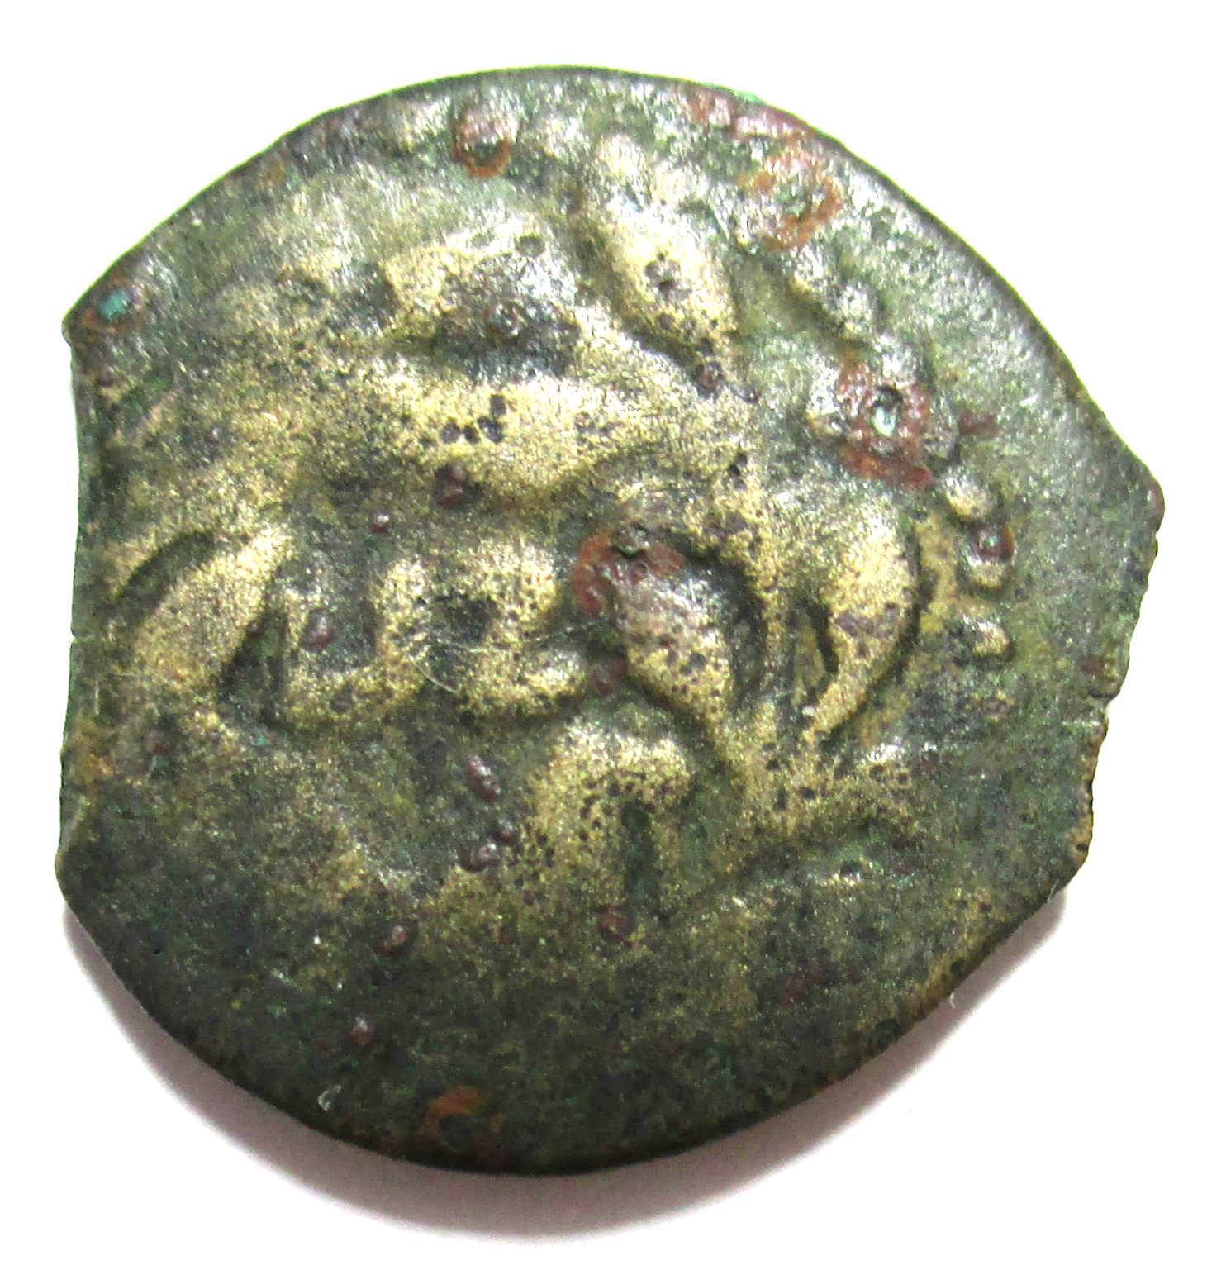


COIN 16 Pontius Pilate
CCCRH #3128
OBVERSE: LIZ = year 17 = 30 CE
(the year of Jesus’ crucifixion)
REVERSE: a lituus (the curved staff used by augurs). Tiberius was the head of the college of augurs (diviners). The Greek words mean ‘of Tiberius Caesar’.

Slide 31
Paying taxes to the Romans
The Jews in Judaea were required to pay taxes in silver coins to the Romans.
When Jesus was teaching in the Temple in Jerusalem he was asked whether the Jews should pay the tax.

Slide 32

Jesus asked to be shown a denarius and said, “Give to Caesar what is Caesar’s and to God what is God’s”. (Mark 12:15)

Slide 33

COIN 17 Denarius of Tiberius
CCCRH #2677
This is the coin commonly thought to be held by Jesus.
OBVERSE: The Latin words mean ‘Tiberius Caesar, son of the divine Augustus, Augustus’.
REVERSE: Livia. Pontif Maximus means ‘High Priest’. Tiberius was the Roman high priest.

Slide 34

COIN 18 Silver Coin (tetradrachm) of Tiberius
CCCRH #2817
This coin was minted at Antioch during the reign of Tiberius. It is probably the coin that was shown to Jesus.
OBVERSE: Tiberius with Greek words meaning ‘Tiberius Augustus Caesar”
REVERSE: Augustus wears a radiate crown. The Greek words mean ‘God (or Divine) Augustus Caesar’.

Slide 35
Paying the Temple Tax
All Jews were required to pay a tax in silver coins for the upkeep of the Temple.
According to Exodus 30:13 the tax was half a shekel, which at this time corresponded to the didrachm (two drachms) which was minted at Tyre, a busy seaport in Phoenicia.

Slide 36

In Matthew 17:24-27 when officials came to collect the temple tax Jesus told Peter to catch a fish and it would have a coin in its mouth to pay the tax for both of them.
Jesus might have meant that Peter could earn the money by fishing.

Slide 37


COIN 19 Tetradrachm (shekel) of Tyre
CCCRH #299
OBVERSE: Heracles (Hercules) wears a crown of laurel leaves. He was the son of Jupiter and a mortal woman.
REVERSE: an eagle was a symbol of Jupiter. The club was a symbol of Heracles. The date is 10 CE.

Slide 38

Jesus saw a poor widow put two small coins into the temple treasury.
He said it was all she had.

Slide 39


COIN 20 The Widow’s Mite
CCCRH #110
Small coins of Alexander Jannaeus (103-76 CE) were still being minted many years after his death. The poor widow probably gave two of these coins.
OBVERSE: star. In Numbers 24:17 there was a prophecy that a star would arise out of Jacob.
REVERSE: anchor with ‘of King Alexander’ in Greek.

