Slide 1
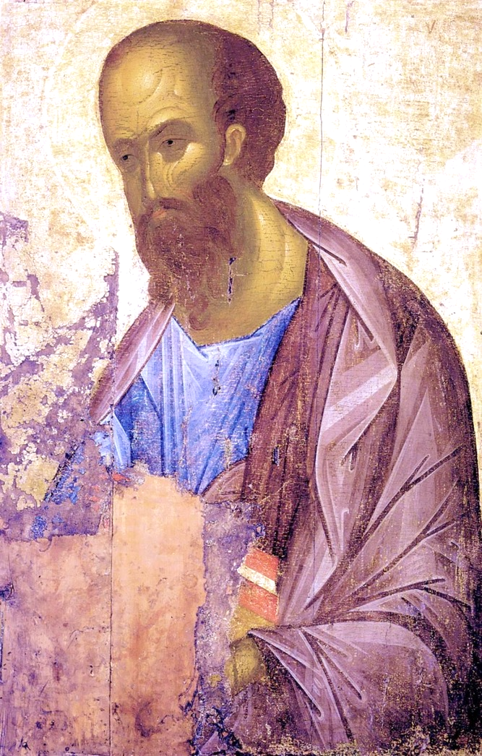
Centre for Coins, Culture and Religious History Foundation
Coins of the cities visited by St Paul
Part 1
Icon by Andrej Rublev 1407

Slide 2
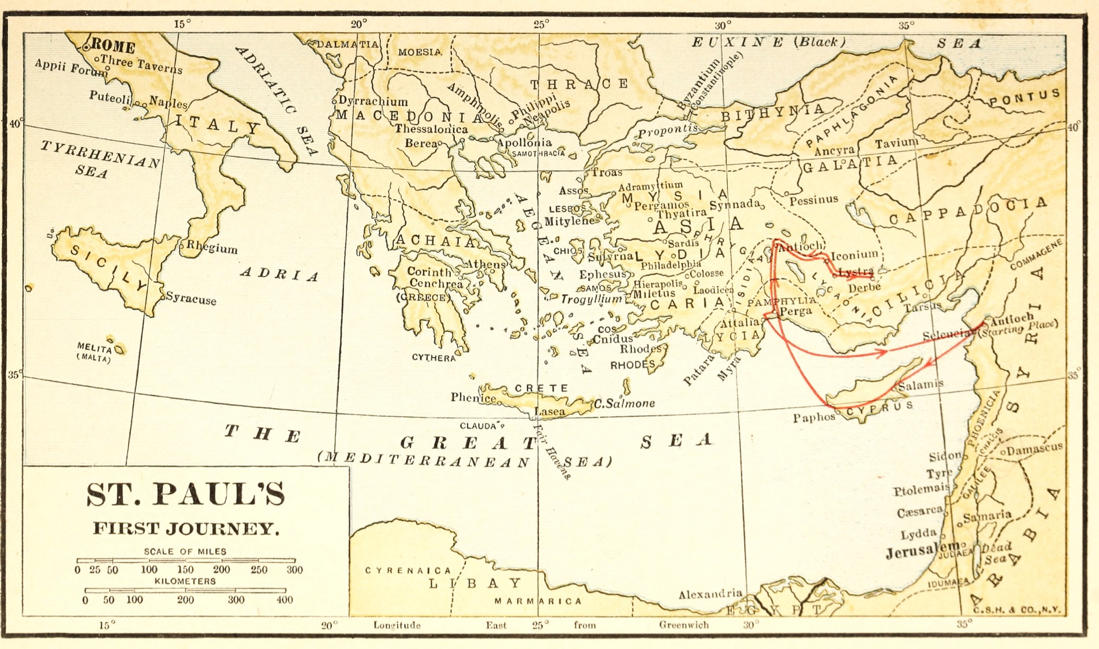

Slide 3
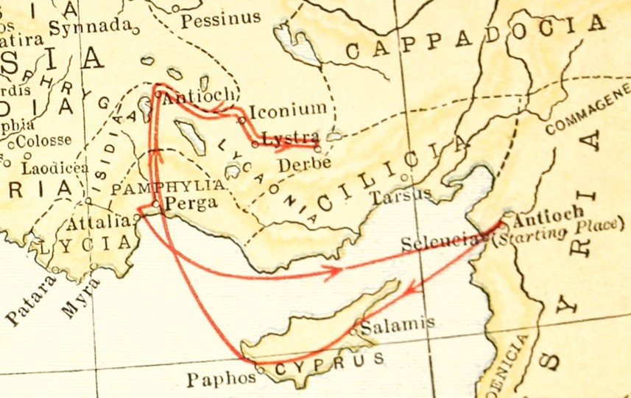

Slide 4
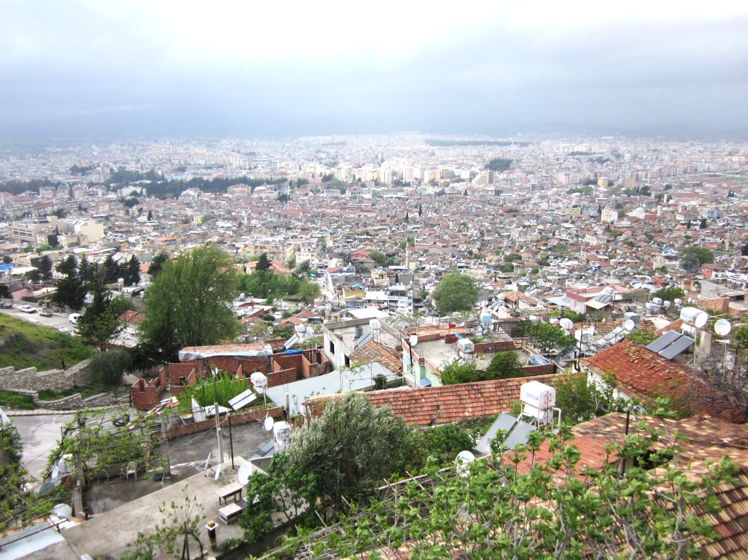
ANTAKYA
(ancient Antioch)
The followers of Jesus were first called Christians in Antioch. (Acts 11:26)

Slide 5
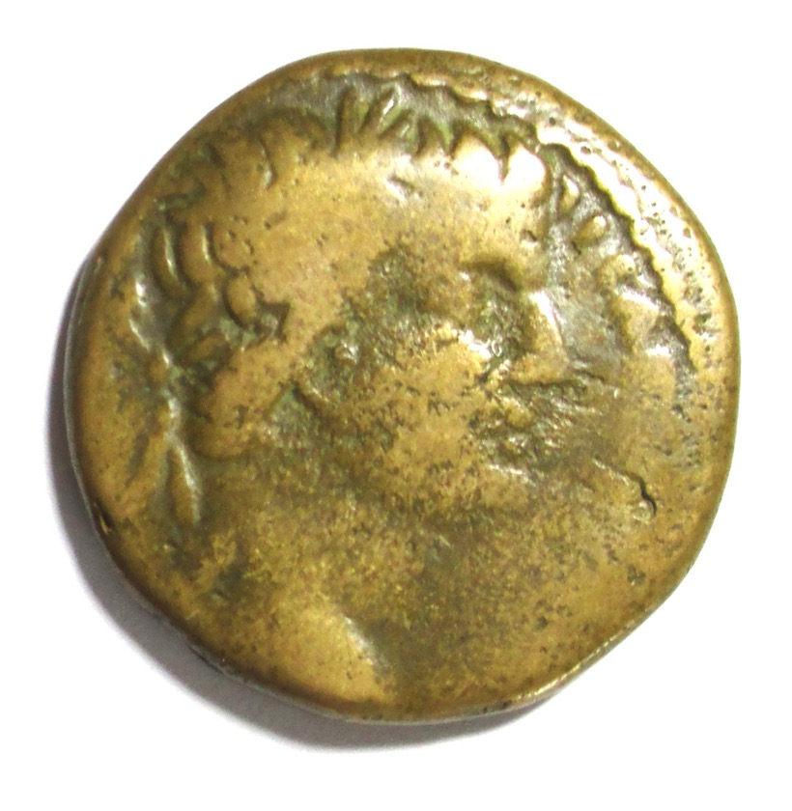
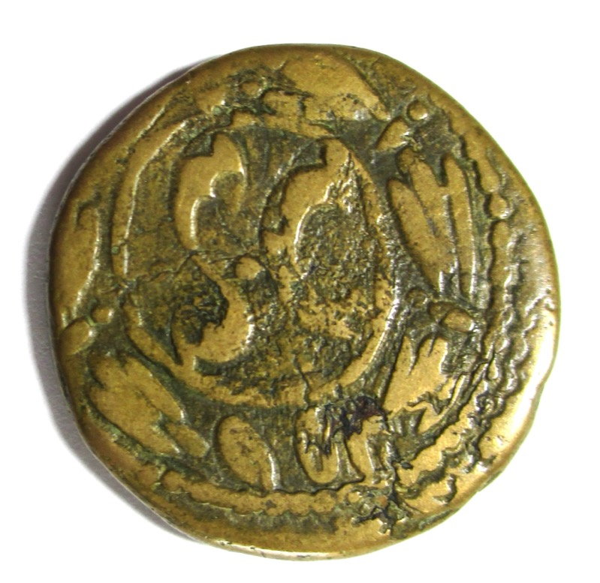
Paul in Antioch 46 AD
Coin of Emperor Tiberius minted at Antioch in 31 AD. Jesus was crucified in 30 AD.

Slide 6
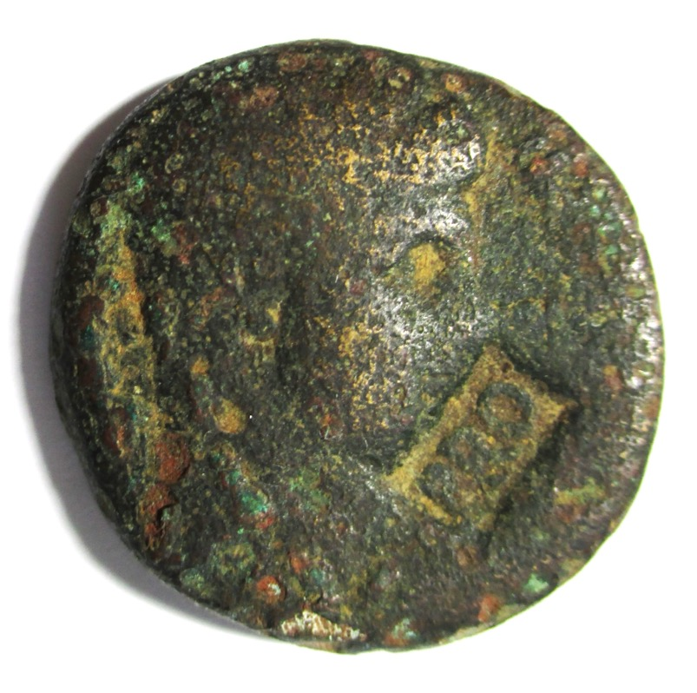
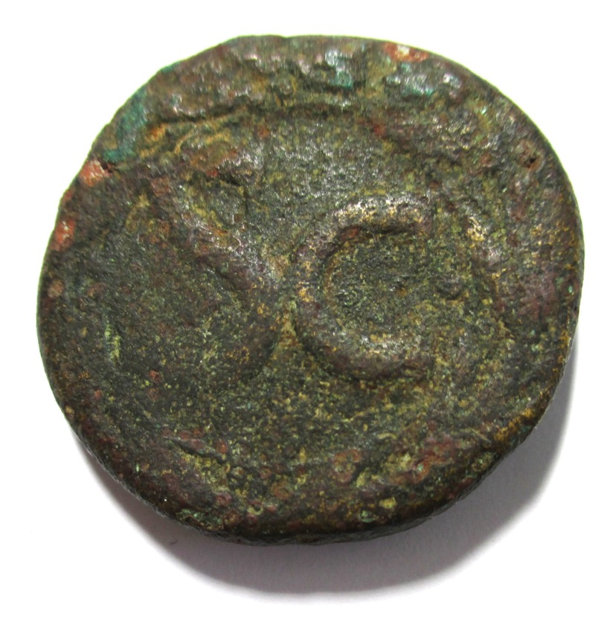
Paul in Antioch 46 AD
This coin of Claudius was minted in 41 AD and is so worn that a countermark PRO (for PROBATUM = approved) was applied. There is a good chance that some of the first Christians including Paul handled it.

Slide 7
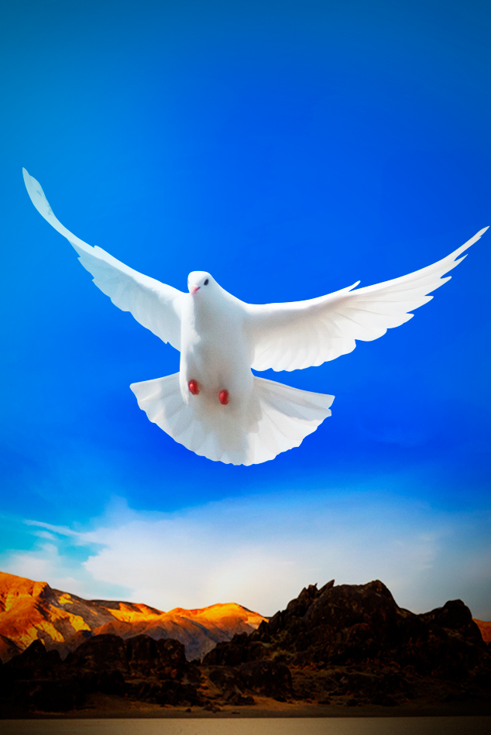
Acts 13:1-3
In the church at Antioch there were prophets and teachers: Barnabas, Niger, Lucius, Manaen and Saul. While they were worshiping the Lord and fasting, the Holy Spirit said, “Set apart for me Barnabas and Saul for the work to which I have called them.”
The two of them, sent on their way by the Holy Spirit, went down to Seleucia and sailed from there to Cyprus.

Slide 8
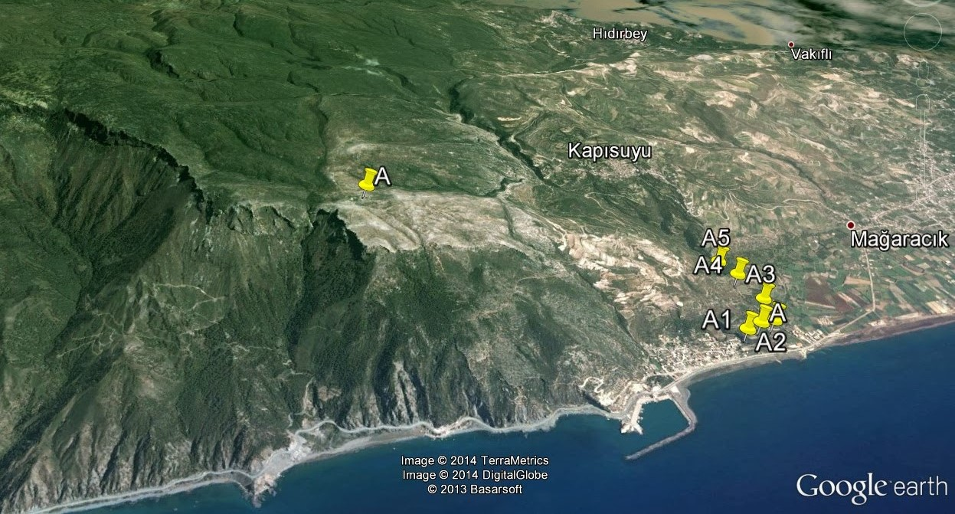
The yellow pins show the site of a water channel.
Seleucia

Slide 9
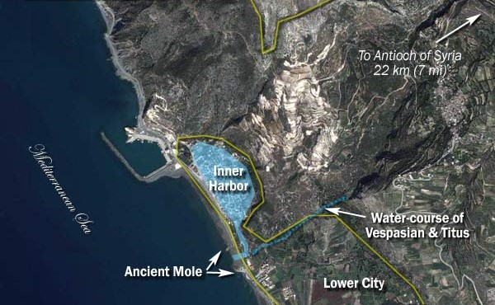
Upper City
47 AD

Slide 10
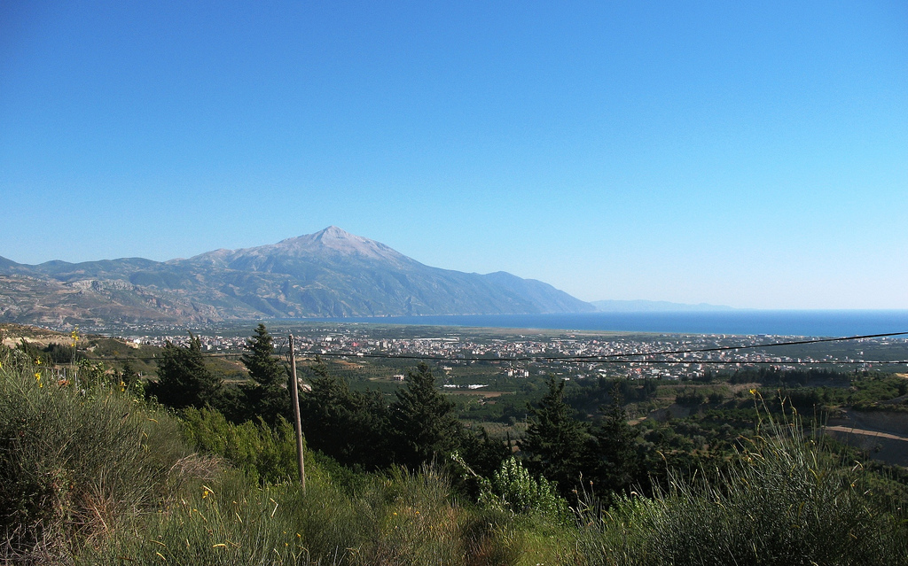
Mt Casius (Jebel Akra) from Seleucia

Slide 11
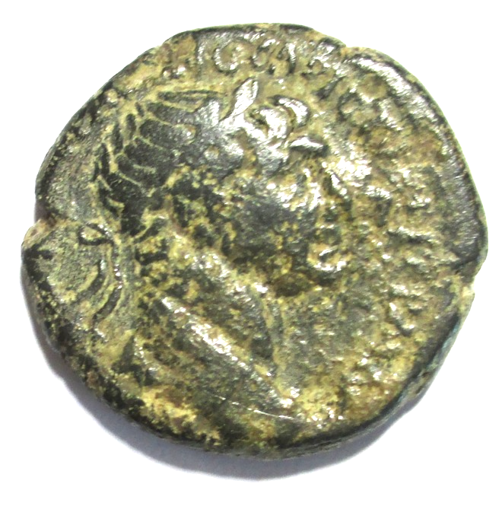
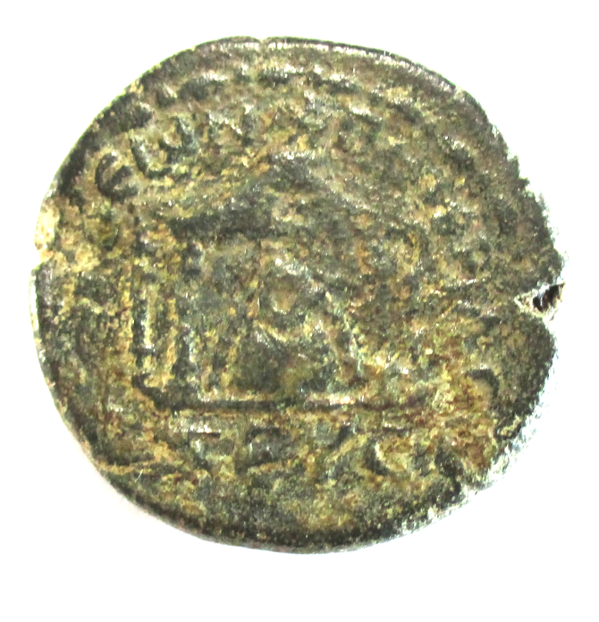
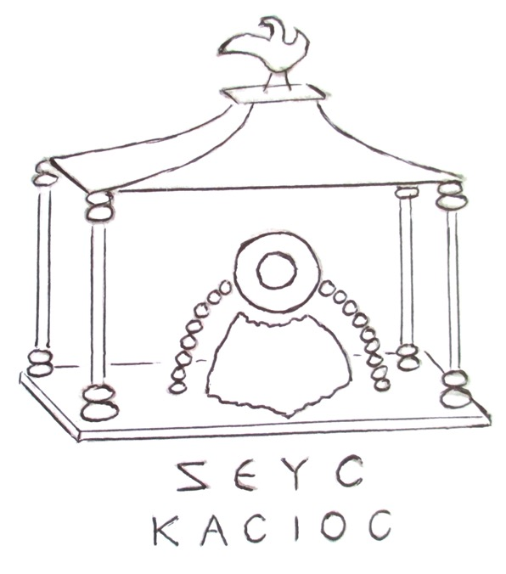
Paul in Seleucia 47 AD
This coin of Emperor Trajan (98-117 AD) was minted at Seleucia and shows the temple of Zeus on the summit of Mt Casius. Today there is just a heap of ash and rubble.

Slide 12
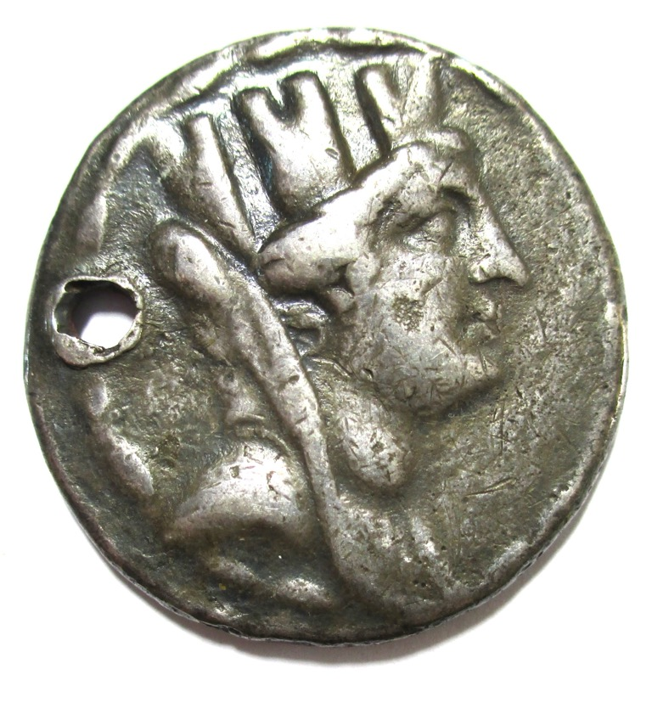
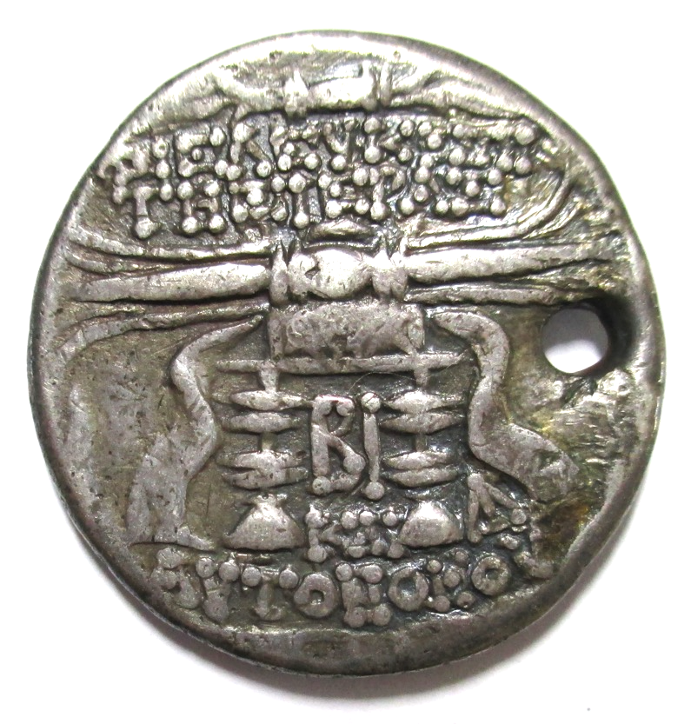
Paul in Seleucia 47 AD
This silver coin was minted at Seleucia in 98 BC and shows the city goddess and a thunderbolt (symbol of Zeus) on a cushion on a stool.

Slide 13
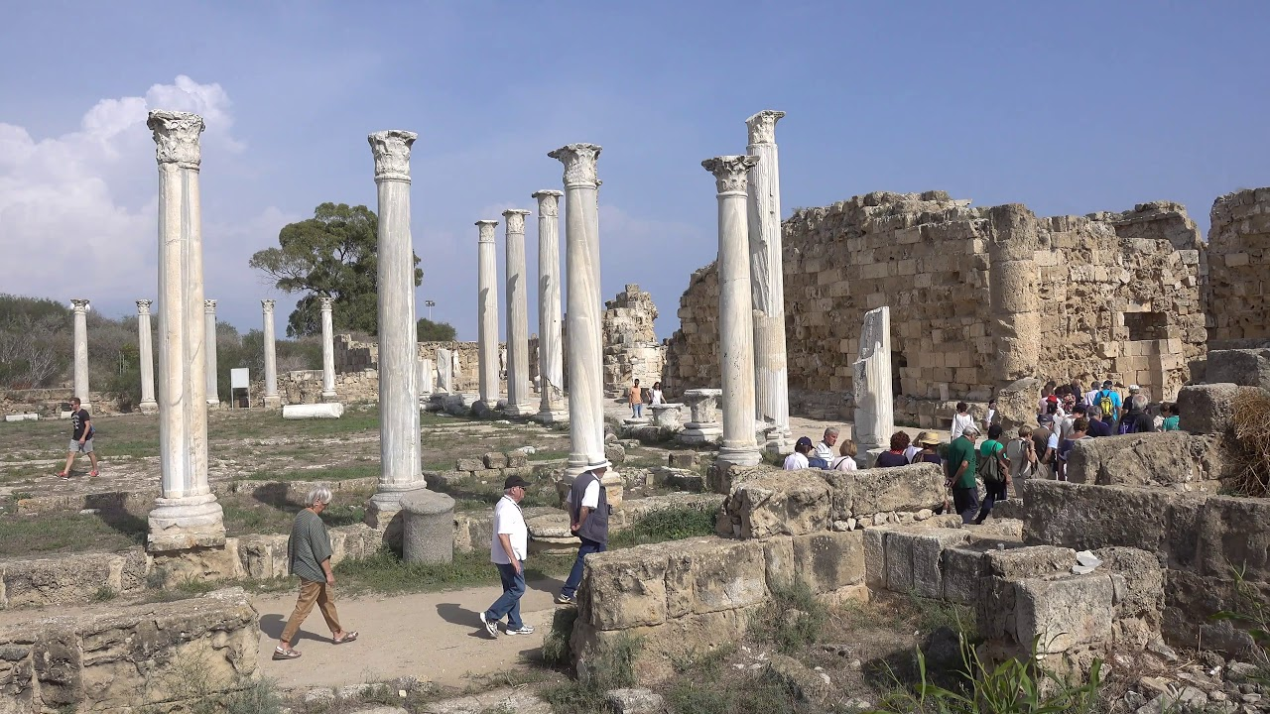
Ruins of Salamis

Slide 14
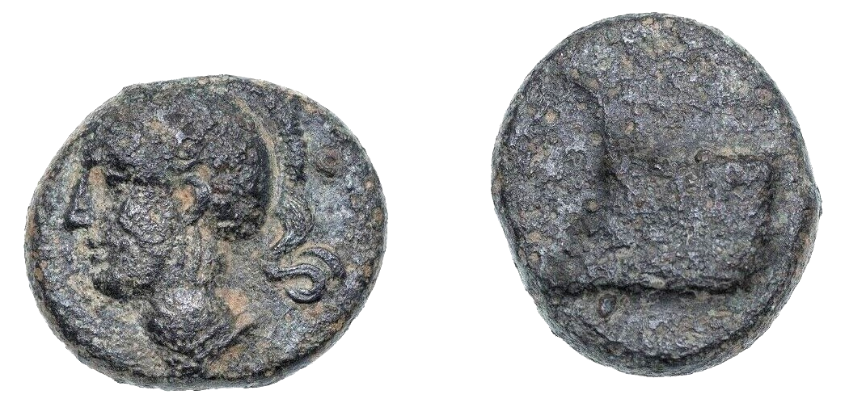
Paul in Salamis 47 AD
This coin was minted at Salamis in about 320 BC and shows Athena and the prow of a warship.

Slide 15
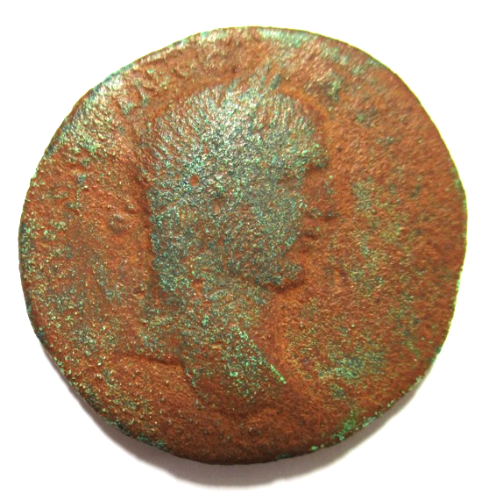
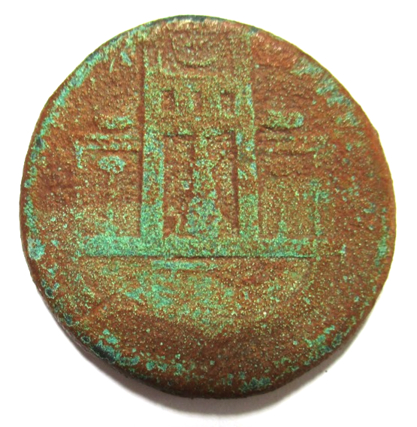
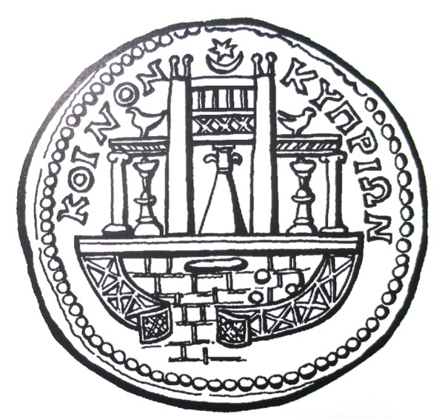
Paul in Paphos 47 AD
This coin was minted at New Paphos by Caracalla (198-217 AD). It shows the temple of Aphrodite at Old Paphos 9 miles to the east.

Slide 16
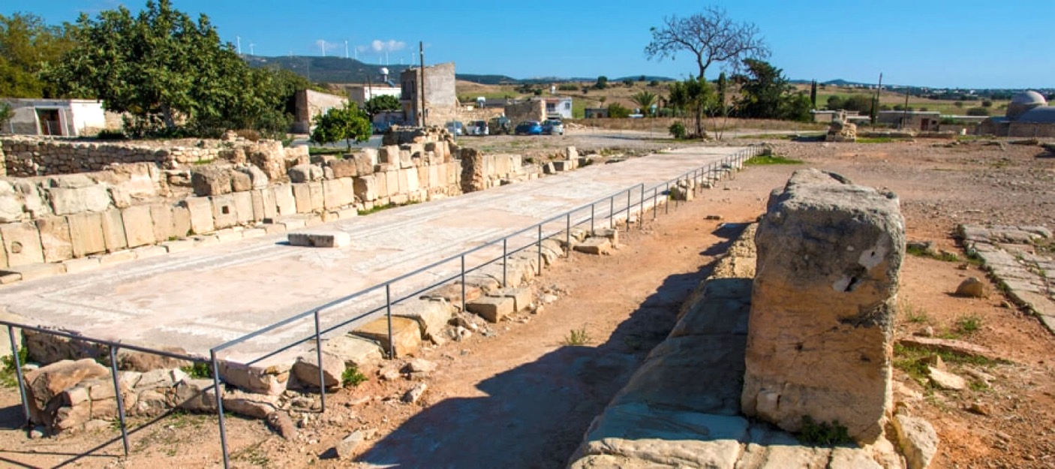
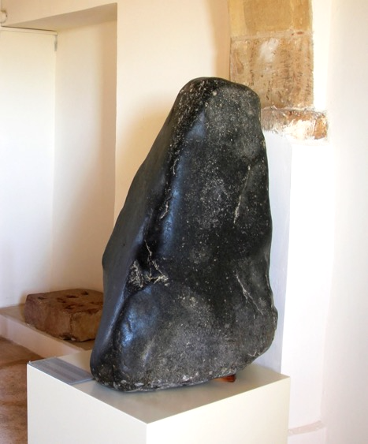
Old Paphos
Conical stone in museum.
If a dove landed on top of the stone it meant that the goddess was present.
Ruins of the temple of Aphrodite

Slide 17
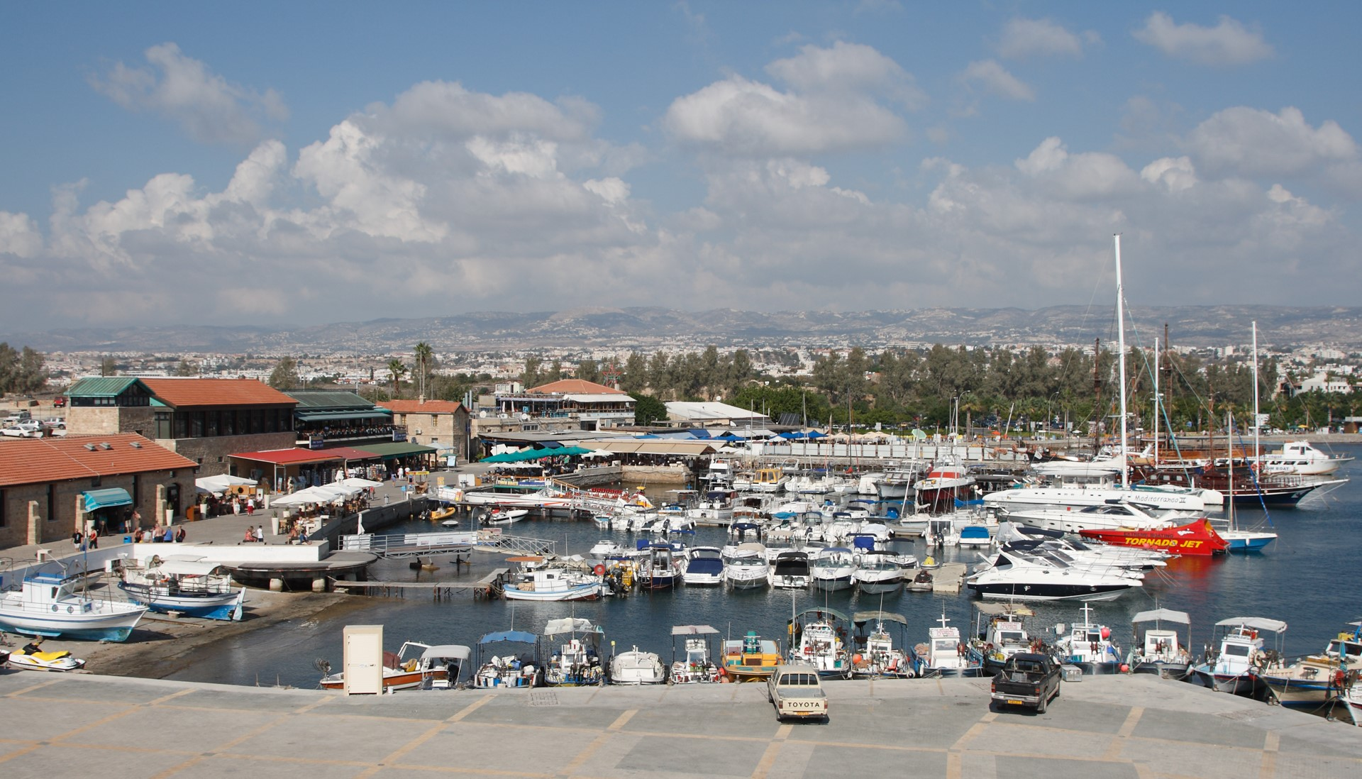
PAPHOS

Slide 18


Slide 19
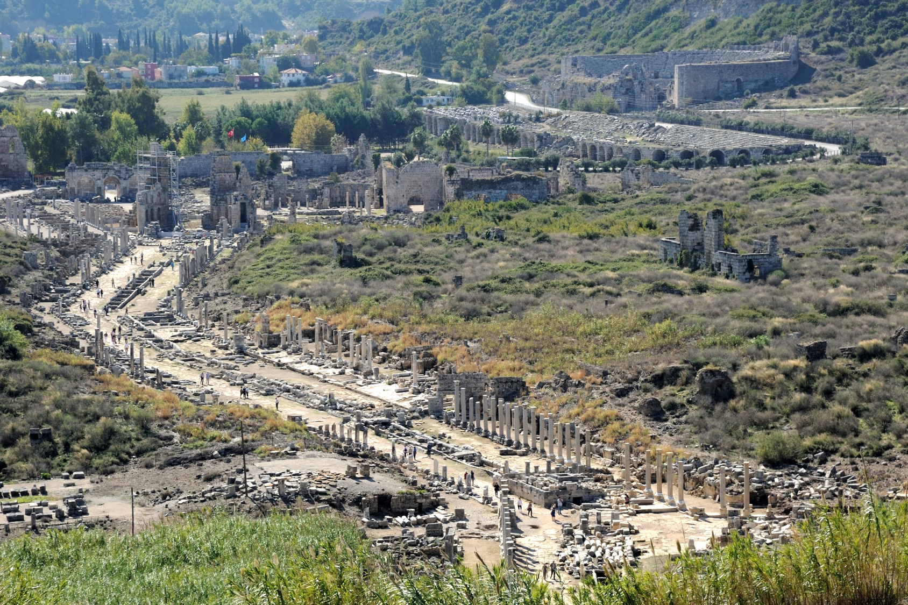
PERGA
is 20 kms inland.

Slide 20
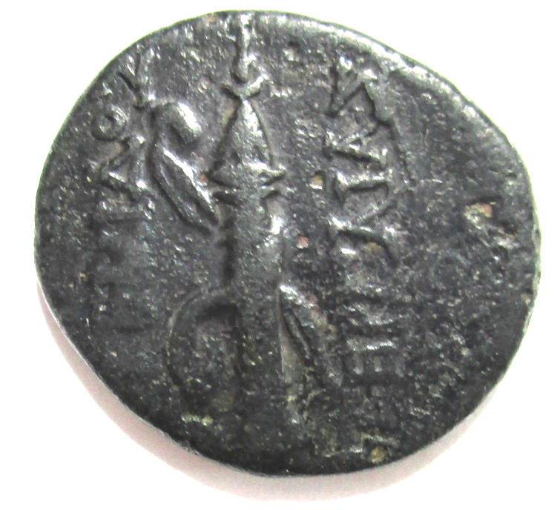
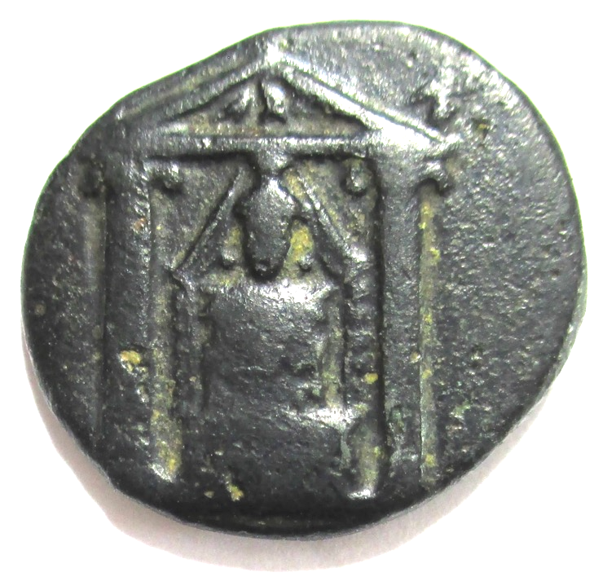
Paul in Perga 48 AD
This coin of Perga is from about 50 BC. It shows symbols of the goddess Artemis (a bow and quiver) and her idol in a temple.

Slide 21
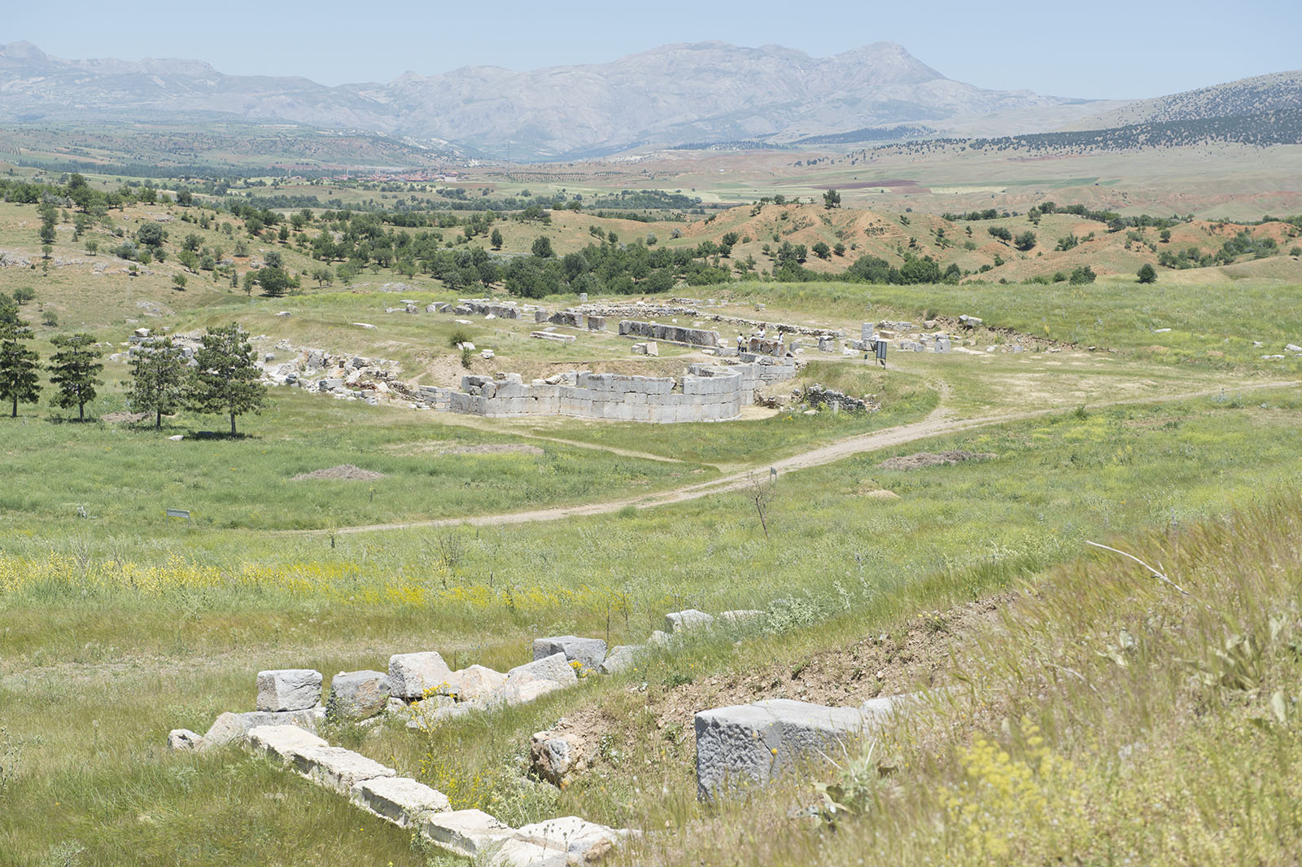
Pisidian Antioch

Slide 22
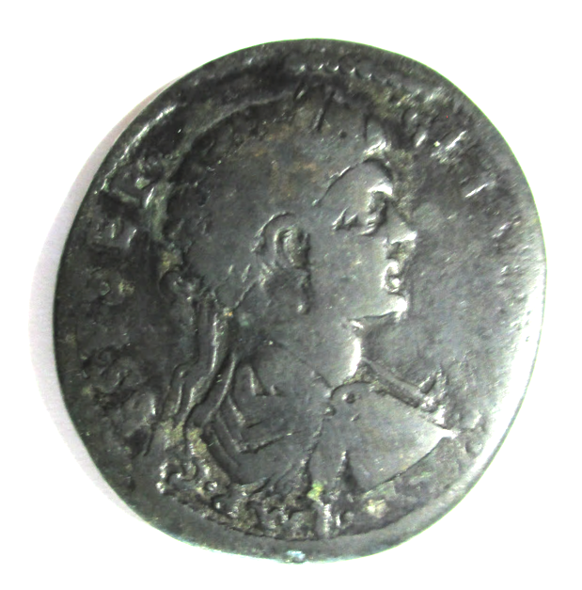
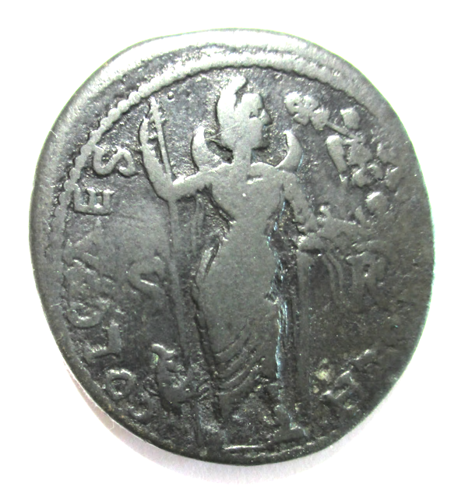
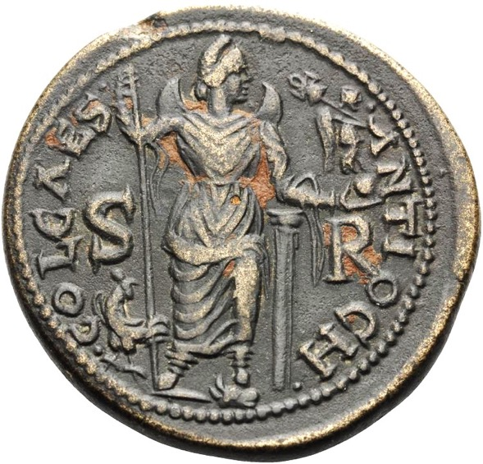
Paul in Pisidian Antioch 48 AD
The moon-god Mên is on this coin of Geta (209-212) minted in the city.

Slide 23
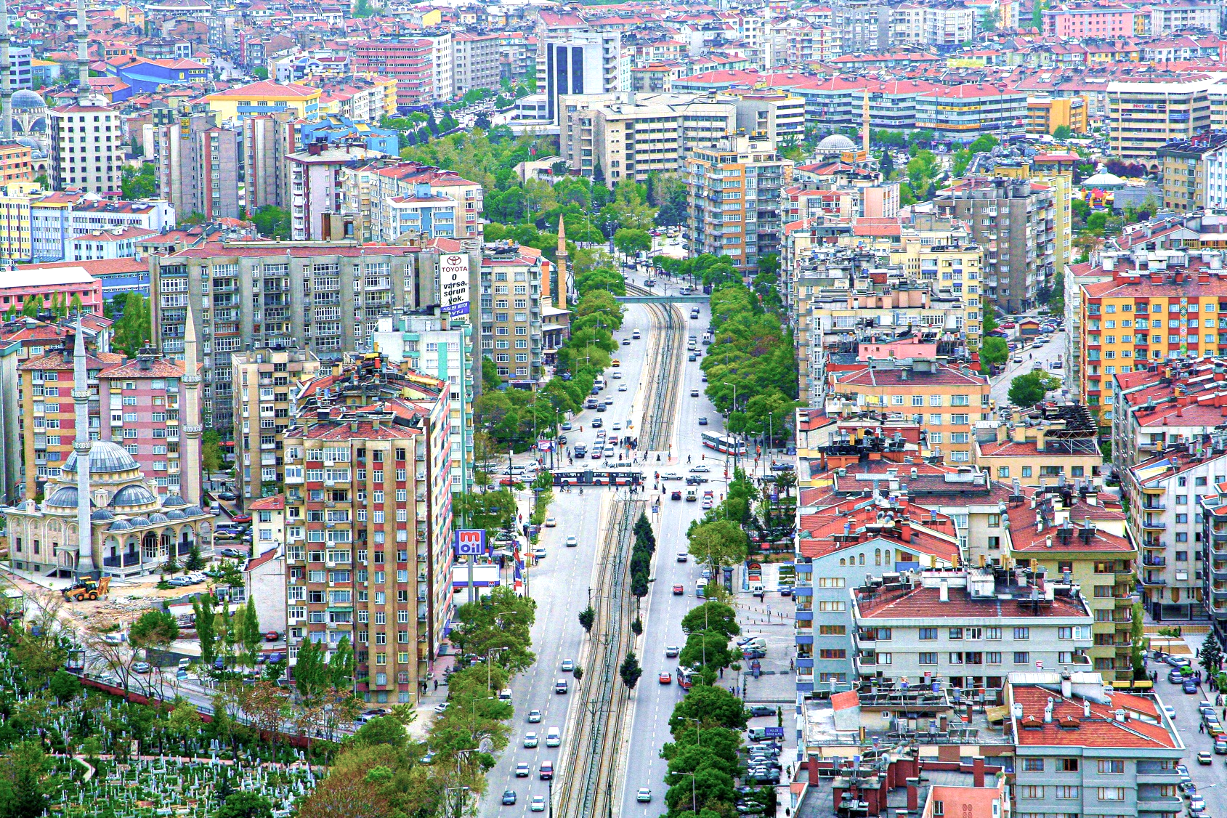
Konya (ancient Iconium) is a modern city.

Slide 24
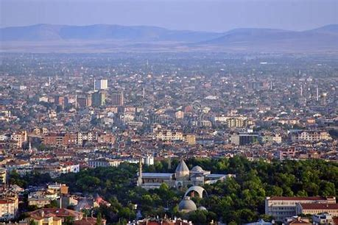
In the centre of KONYA a mosque is on a hill.
Rumi lived in Konya in the 13th century.

Slide 25
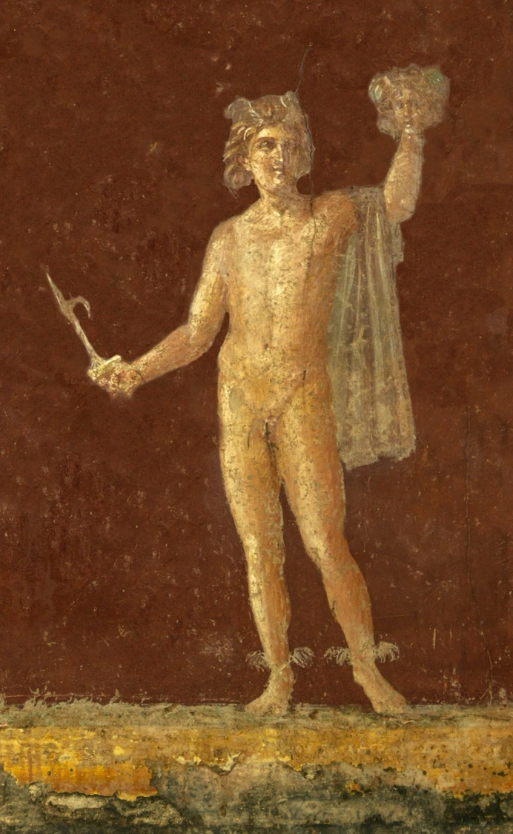
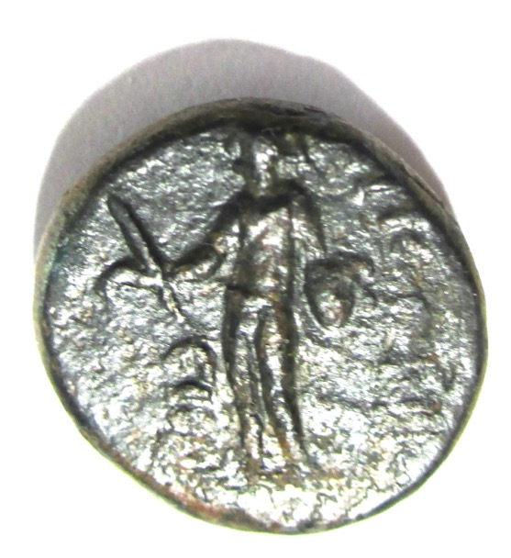
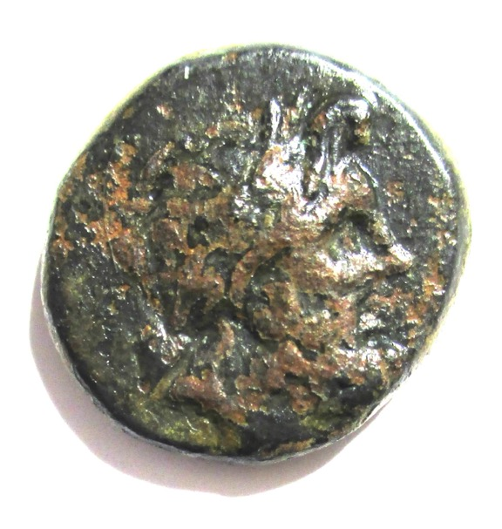
Paul in Iconium 48 AD
Zeus and Perseus appear on this coin minted at Iconium in 50 BC. In a fresco in a villa at Stabiae Perseus holds the head of Medusa and the harpa (hooked sword). The fresco was made in 50 AD.

Slide 26
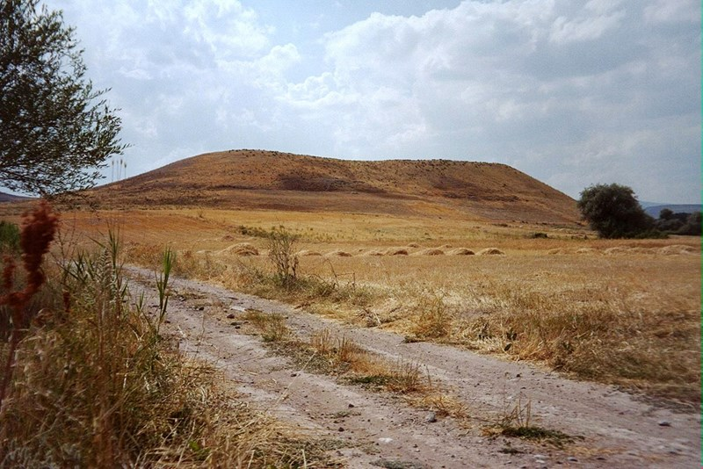
The mound of LYSTRA

Slide 27
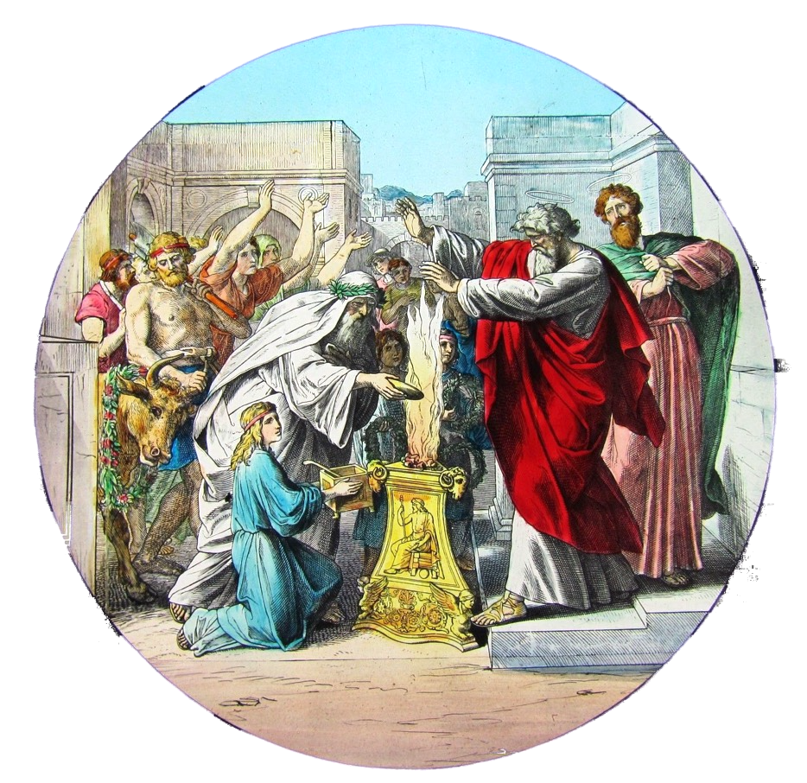
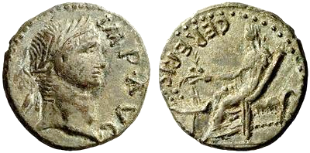
Paul in Lystra 48 AD
On this coin of Augustus (29 BC-14 AD) minted at Lystra, Ceres holds ears of grain over a lighted altar.
The people thought Paul and Barnabas were gods.

Slide 28
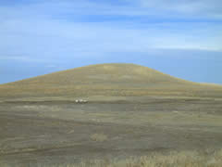
Mound of Derbe

Slide 29
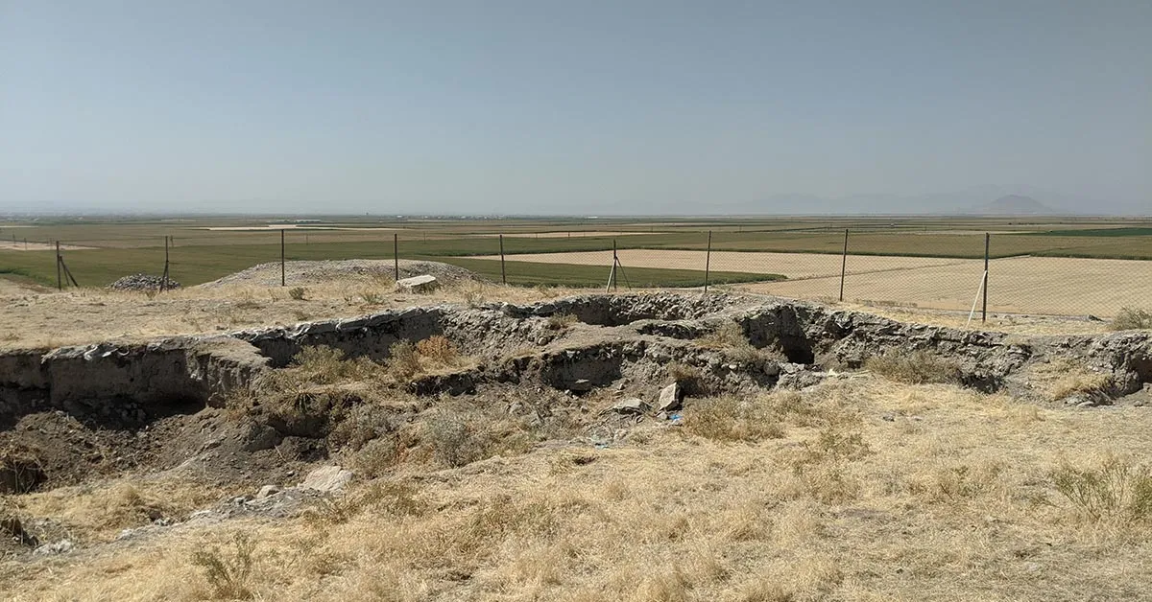
On top of the mound of Derby

Slide 30
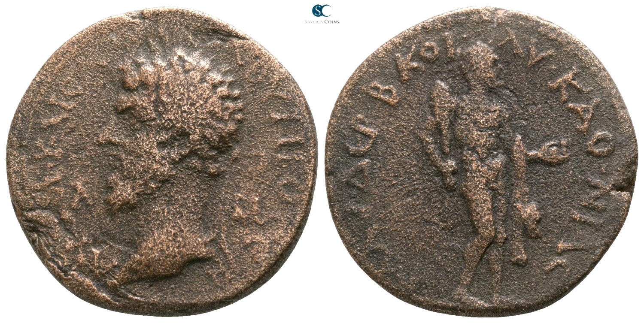
Paul in Derbe 48 AD
Coin of Lucius Verus (161-169) minted in Derbe. Heracles holds apples.

Slide 31
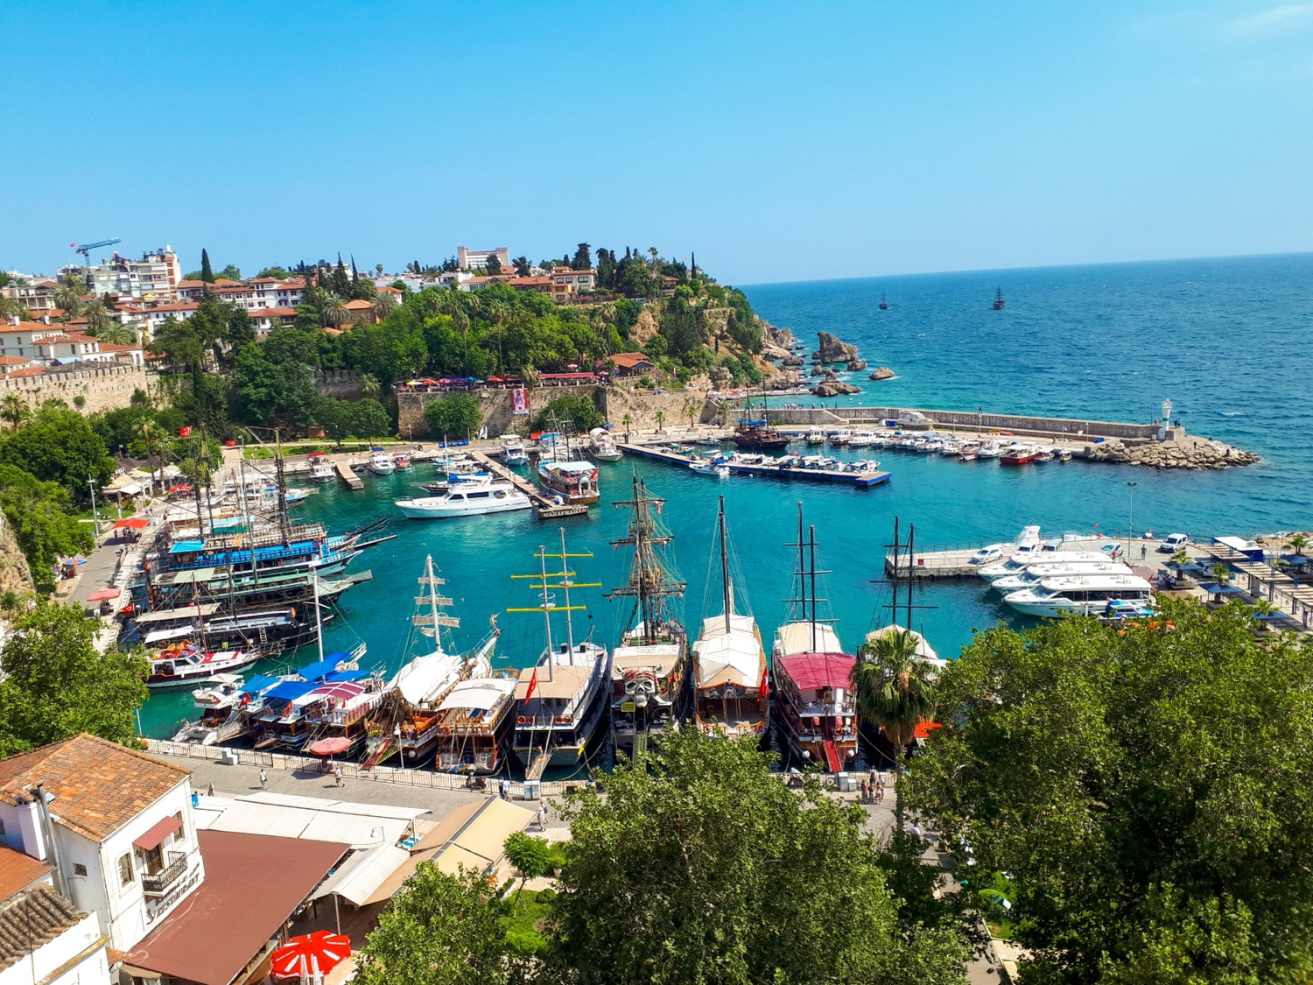
ANTALYA (ancient Attalia)
It was founded by Attalus II c. 150 BC.

Slide 32
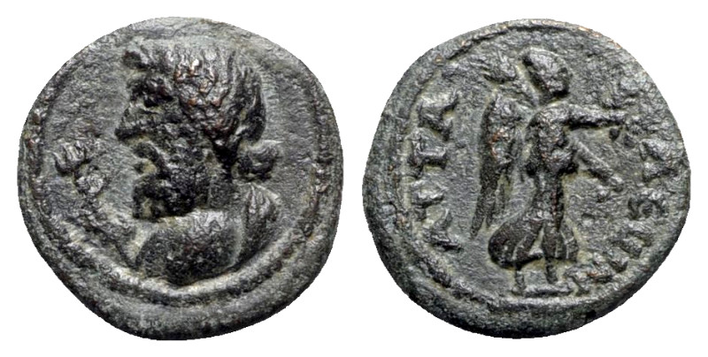
Paul in Attalia 48 AD
Poseidon and Nike appear on this coin minted at Attalia in the 1st century AD.

Slide 33
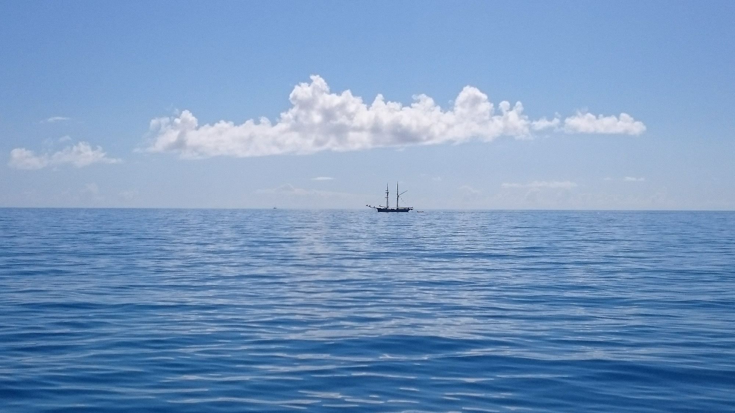
End of Part 1

